Slide 1
The Brief History of Buddhism in Vietnam
Presented by
Ven. Nguyen Van Nam

Slide 2
The Brief History of Buddhism in Vietnam
1. The Introducing and Forming (1st B.C.- 5th C.E.)
2. The Development (5th -11th C.E.)
3. The National Religion (11th – 14th C.E.)
4. The Decay (14th -19th C.E.)
5. The Revival (20th C.E.)
6. Nowadays

Slide 3
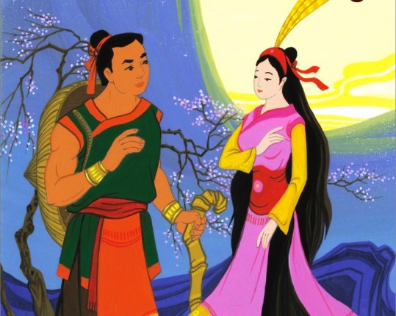
1. The Introducing and Forming (1st B.C.- 5th C.E.)
Phật Quang (Buddhāloka) and Chữ Đồng Tử - Tiên Dung: The First Buddhist layperson. (Lĩnh Nam Chích Quái [Outstanding Figures of Southern Vietnam])
Prof. Lê Mạnh Thát states that Buddhism existed in Vietnam since 2nd BC. (History of Buddhism in Vietnam, p.28)

Slide 4
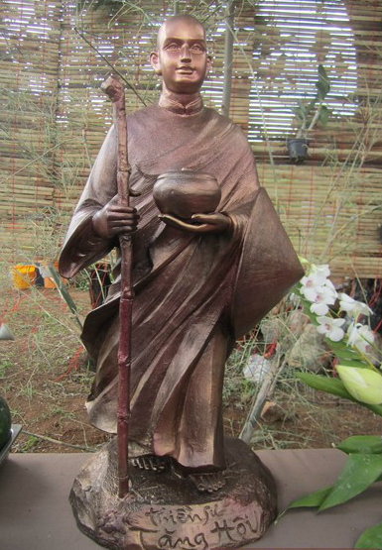
1. The Introducing and Forming (2nd B.C.- 5th C.E.)
Khương Tăng Hội (?-280 C.E) – the First Zen Master in Vietnam (Thich Nhat Hanh, Tăng Hội – The First Master of Zen Vietnam at Giao Chau in the Early Third Century)
Lục Độ Tập Kinh – The Collected Discourses on Pāramitā.

Slide 5
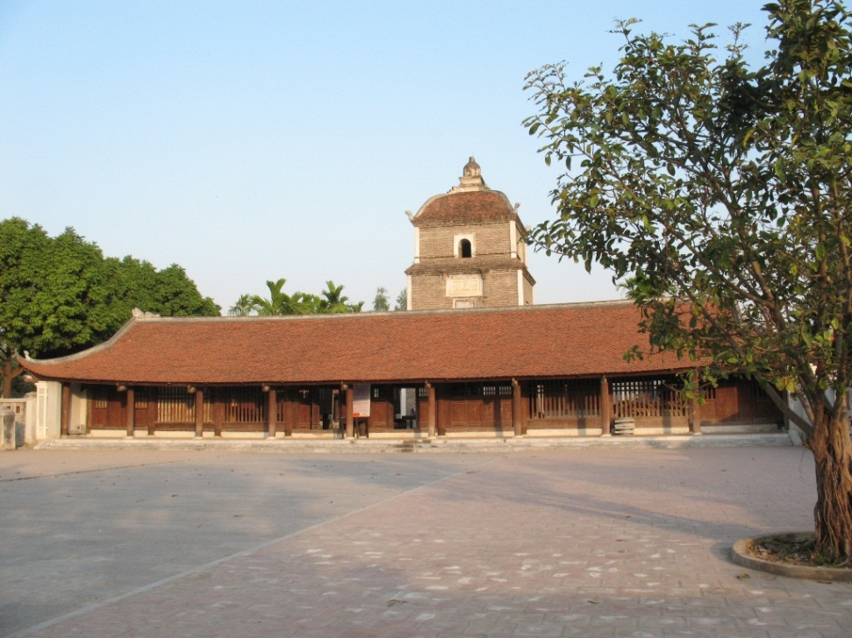
1. The period of introducing and forming (1st B.C.- 5th C.E.)
Luy Lâu Buddhist Center in Giao Chỉ (Ninh Bình province) 1st C.E.
20 great temples
500 monks
15 sutras
(Le, Manh-That, History of Buddhism in Vietnam, p.15-16)
Dâu temple in Ninh Bình Province (1st C.E)

Slide 6
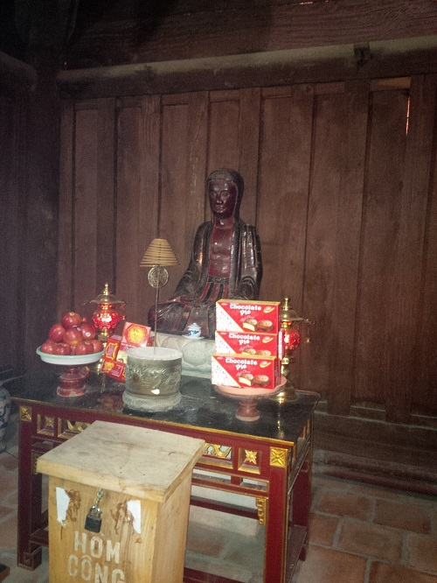
2. The Development (6th -11th C.E.)
Tỳ Ni Đa Lưu Chi – Vinītāruci (?-592) and His Zen School.
Arriving at Trường An in 574 AD.
Staying in Dâu Temple in 580.
Translating ‘Monastery of Elephant’s Head Sūtra’ and the Different Kammā Sūtra
19 generations in Tỳ Ni Đa Lưu Chi Zen School.
Tỳ Ni Đa Lưu Chi – Vinītāruci

Slide 7
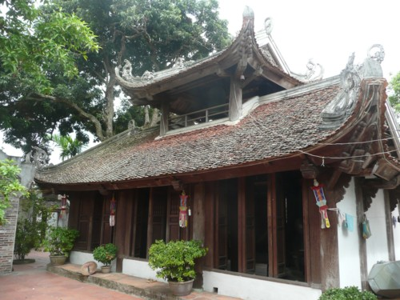
The Development (6th -11th C.E.)
Vô Ngôn Thông (?-826) Zen School.
Arriving at Kiến Sơ temple in 820.
17 generations in the Zen School.
Thảo Đường (?-?), the national master.
Arriving at Vietnam in 1069.
5 generations in the Zen School.
Kiến Sơ Temple in Ninh Bình Province

Slide 8
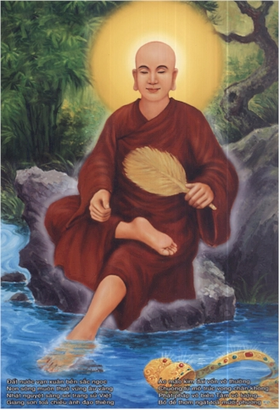
The National Religion (11th – 14th C.E.)
Trần Nhân Tôn (1258-1308) and Trúc Lâm Zen School.
Crowned a king at 20 age
Defeating two Chinese invasions
Giving a throne to his son at 35 age
Ordained full precepts at 41 age
Founding Trúc Lâm Zen School and traveling around the nation to teaching Dharma
Developing Engaged Buddhism

Slide 9
4. The Decay (14th -19th C.E.)
Not appearing any new buddhist school, any famous Zen master And any remarkable Buddhist work.
Decreasing a number of temples, monks, nuns and Buddhist laypersons
Not supporting of kings and intellectual classes
Existing bad things in Sangha
Discriminated by Confucianists
Occurring various Wars
Controlled by French and developing Catholicism

Slide 10
5. The Revival (20th C.E.)
The most ven. Khánh Hòa started the movement of the Buddhist Revival in 1920
Lớp Phật Học Gia Giáo: The Class of Monastery Buddhology in 1920
An Nam Nam Phật học viện: Annam Buddhology school in 1932 in Thừa Thiên Huế
Lưỡng Xuyên Phật học viện: Luong Xuyen Buddhology school in 1934 in Trà Vinh province
Magazine and newspaper:
Pháp Âm (Dharma Sound) in 1929
Từ Bi Âm (Metta Sound) in 1931
Đuốc Tuệ (Wisdom Light) in 1935
Tiếng Chuông Sớm (Early Big-Bell Sound) in 1935.
Giáo Hội Tăng Già Nam Việt: Nam Viet Sangha Association in 1951
Giáo Hội Tăng Già Nam Việt: The Nam Viet Sangha Association in 1951
Giáo Hội Phật Giáo Việt Nam: The Vietnamese Buddhist Association in 1981

Slide 11
6. Nowadays
Mahayana, Theravada and Khất Sĩ tradition
4 Buddhist Universities in Hanoi, Hue, Hochiminh and Can tho city: training B.A, M.A, and Ph.D
7 senior Buddhist colleges,
30 intermediate Buddhist schools,
over 20 primary Buddhist classes,
15,000 temples and 50,000 monks and nuns and
Over 70 percent of population are Buddhists
(Quảng Tuấn, “Total number of Buddhist around the world,” Báo Giác Ngộ [Enlightenment Magazine], (Ho Chi Minh), Vol.131, (February – 2007), p. 57-58.)

Slide 12
Thanks for Attentions

