Slide 1
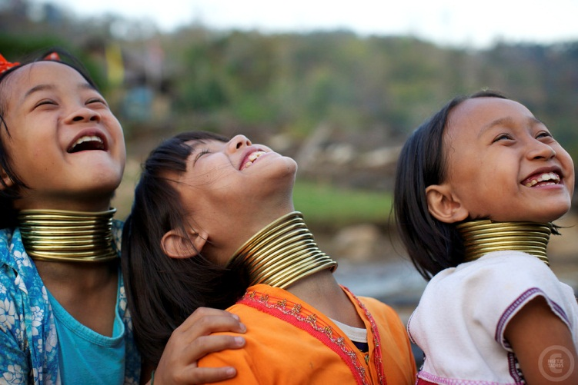
Kayan Buddhism and multicultural society in Kayah state
Presented by
Ashin Indaka

Slide 2
CONTENTS
Kayan history
Population
Religions
Kayan food
Kayan Buddhism
Kayah state
Population
Ethnic group in Kayah state
Famous pagoda
Lawpita Hydropower Project

Slide 3
Kayan Buddhism and multicultural society in Kayah state

Slide 4
History

Slide 5
History The Kayan is a sub tribe of Mon-Hkmer group, minority ethnic of Burma (Myanmar). The Kayan consists of the following groups:
1. Kayan Lahwi (also called Padaung),
2. Kayan Ka Khaung (Gekho),
3. Kayan Lahta,
4. Kayan Ka Ngan.

Slide 6
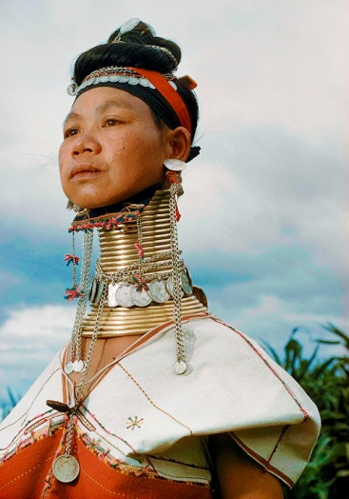
Padaung (Yan Pa Doung) is a Shan term for the Kayan Lahwi (the group whose women wear the brass neck coils). But some Kayan people refer to themselves as Kayan not Padaung any more and object to being called Padaung. They like to be called Kayan.

Slide 9
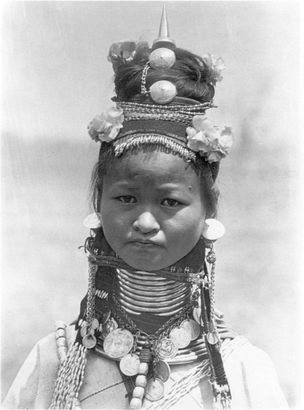
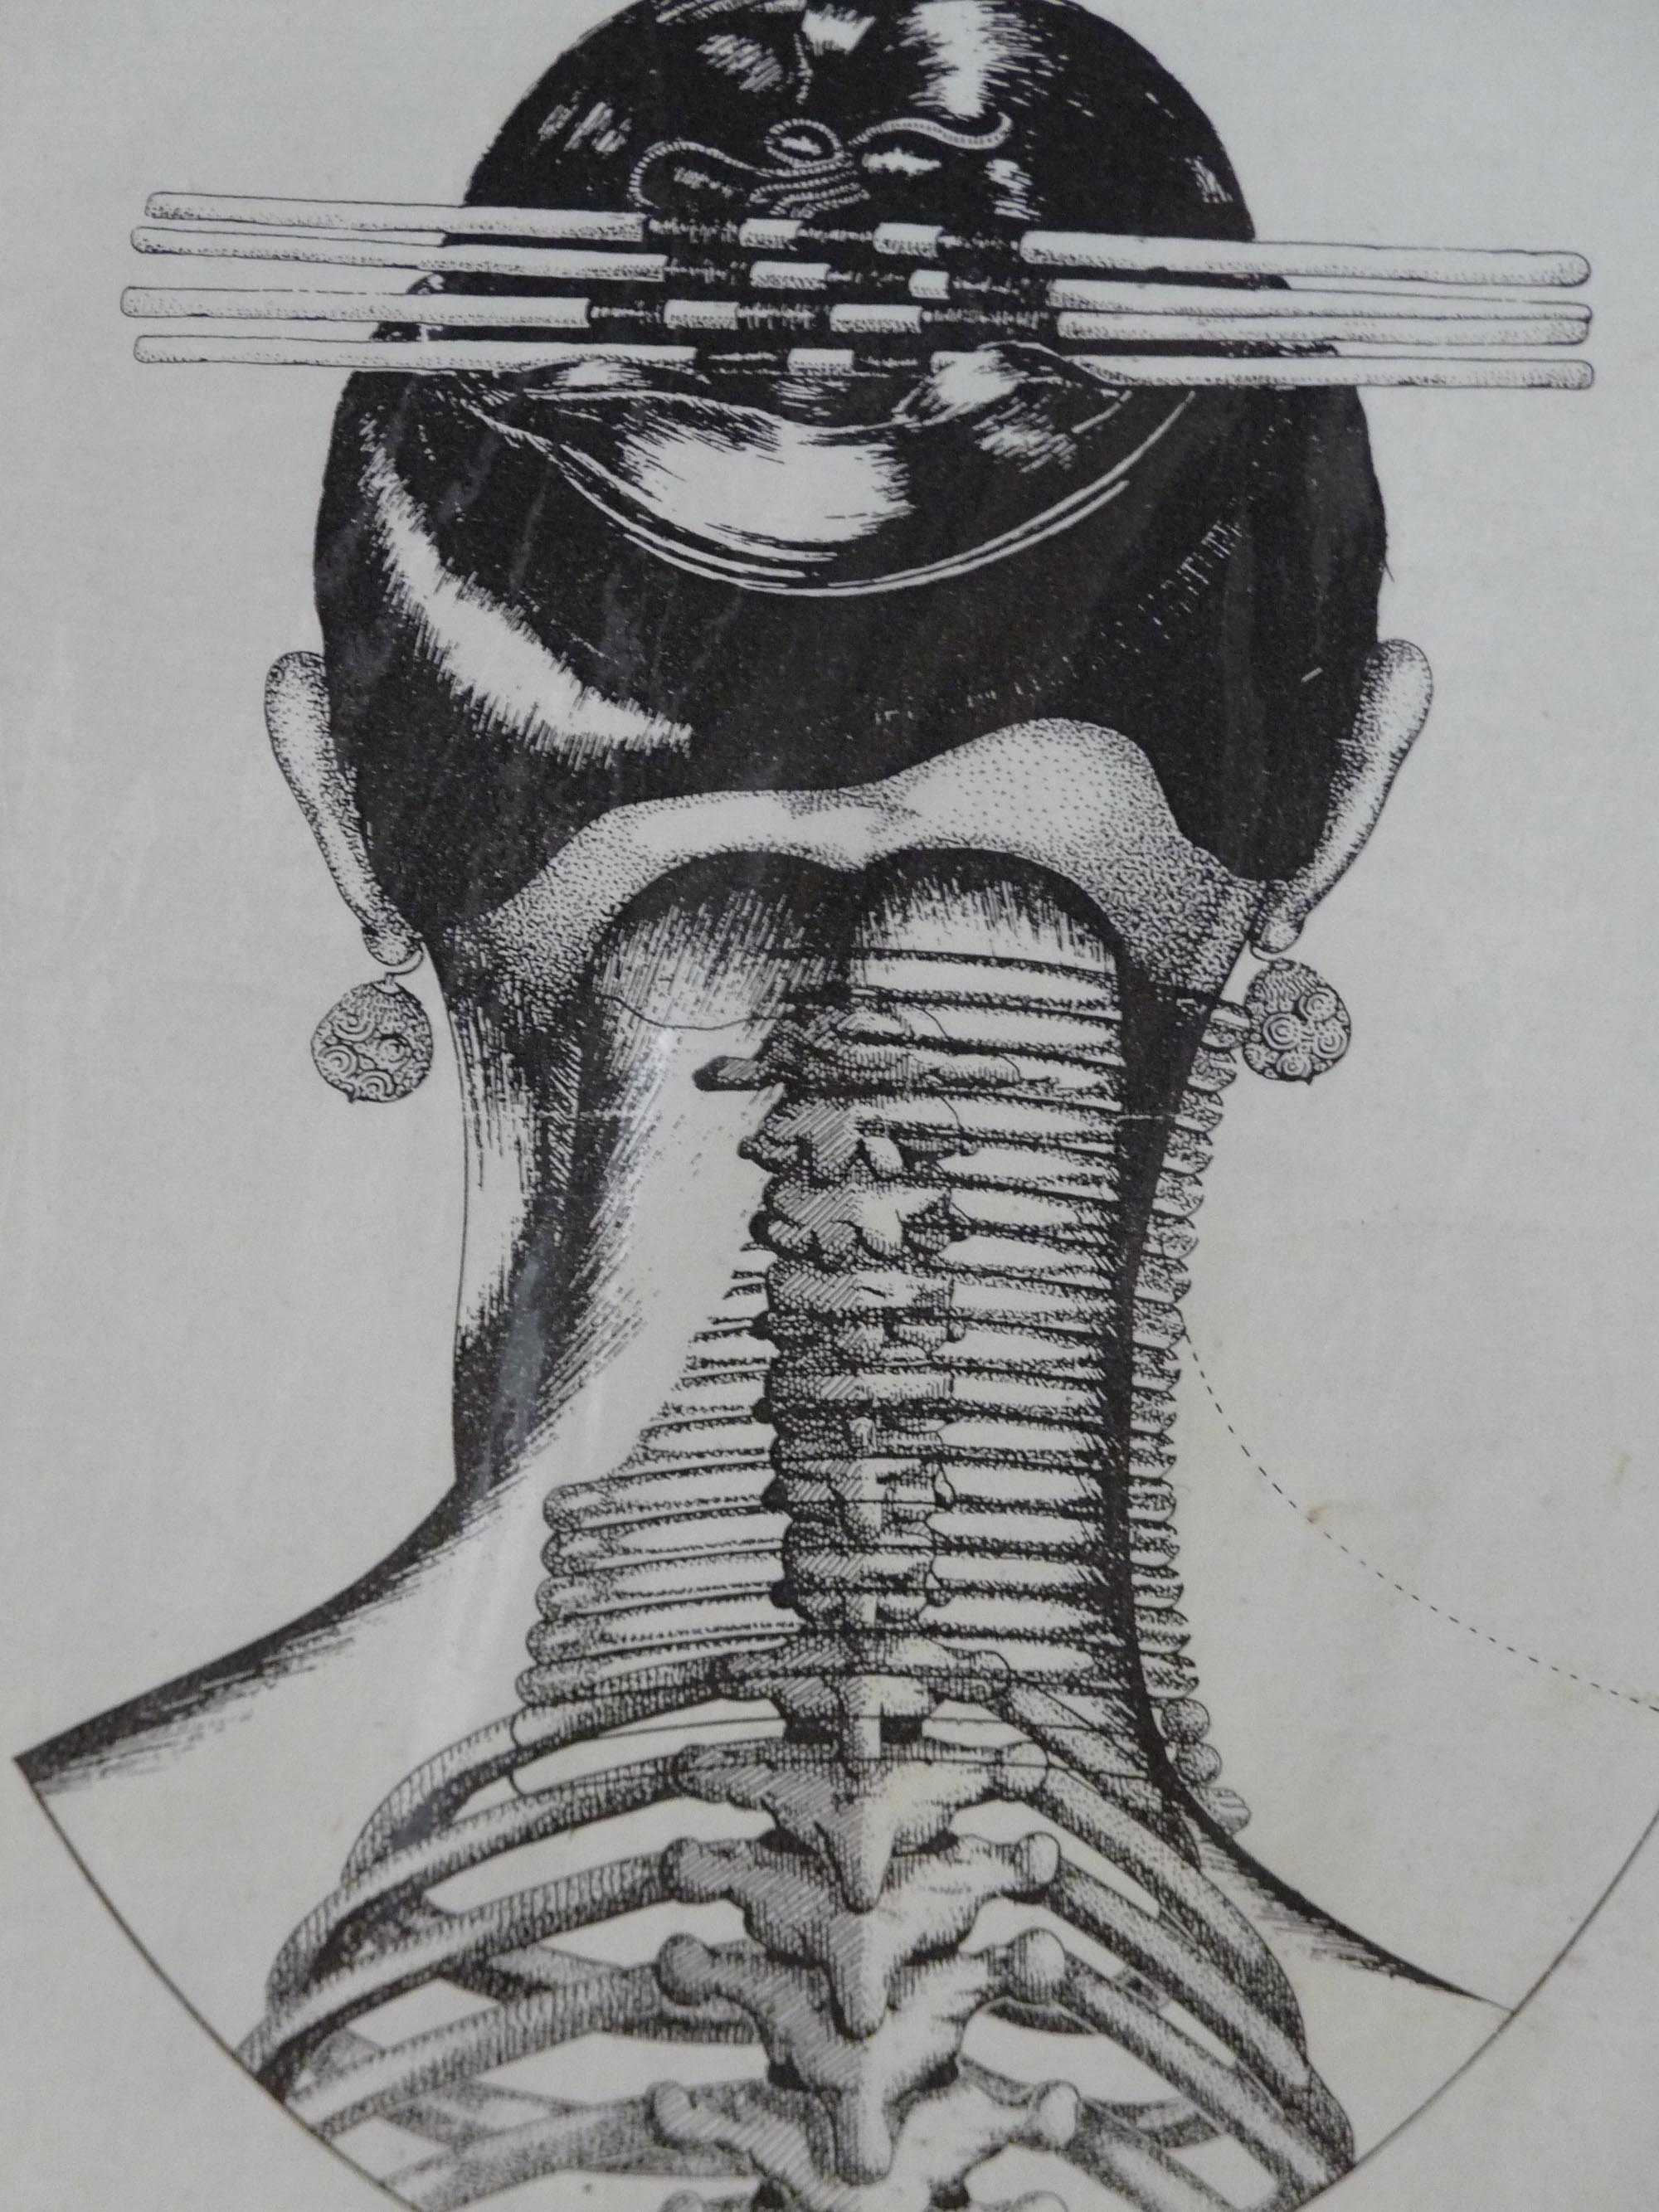

Slide 10
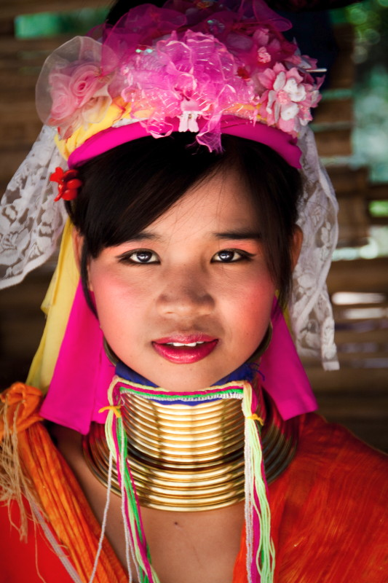

Slide 11
Kayan lived on Mountains at the south Shan State and west of Karenni State(Kayah) since earlier BC 739, 739. During that time Kayan people worship guardians of Mountains and trees. After PEME missionary priests arrive in Taungu some of Kayan converted form Animism to Christianity. In the late 1980s and early 1990s due to conflict with the military regime in Burma, many Kayan tribes fled to the Thai border area.

Slide 12
Population
Kayan number about 60,000 in Shan State (around the Phekon twonship area) and 50,000 in Kayah State (around Demoso and Loikaw). Around 9,000 Kayan lived at the north of Loikaw, Shisai township which is closed to Pa-O people. Still many Kayan are living at the East of Naypyidaw. A 2006 estimate puts the population at approximately 150,000. About 600 Kayan reside in the three villages open to tourists in Mae Hong Son, or in the Ban Mai Nai Soi refugee camp. According to KNGY’s statistics, the latest Kayan population in 2010 is around 402,000.

Slide 14
Kayan settled in the Demawso area of Karenni State (Kayah State) since 739 BC. Today they are found in Karenni (Kayah) State around Demawso and Loikow, in the southern region of Shan State, Phekon and in Mandalay, East of Pyinmana and Karen’s Than Daung township. There are three Kayan villages in Mae Han Son province in Thailand. The largest is Hauy Pyu Keng on the Pai river, close to the Thai Burma border. Huai Seau Tao is a commercial village opened in 1995. Many of the residents of Nai Soi KayanTayar moved into the Karenni refugee camp in September 2008, but a few families remain there.

Slide 16
Kayan region

Slide 17
Religions
Statistics published in 2004
Statistics published in 2004 lists 306 Kayan villages, out of which 209 are Roman Catholic, 19 Kan Khwan, 32 Baptist, 44 Buddhist and 2 Byamaso.
Catholic 68.3%
Buddhist 14.5%
Baptist 10.45%
Kan khwan 6.2%
Byamaso .65%

Slide 19
Catholic Movement to Kayan Region
Catholic Movement to Kayan Region According to Khu kayan, Kayans have been converted to Christianity since 1722. In the year 1858, when the Christian missionary Catholic priest "Bigandat" got to Taungu, he found out that some of the Kayan had already become Christians. In 1868, Catholic priests got to 'Laketho', when the Geba lived for missionary works. Since that time, some Geba began to profess Christianity. The priests who had preached on Christianity were 'Bidefi', 'Tonar Torel', 'Cabon' and 'Tangress Conti', who were sent by the priest 'Bigandat'.

Slide 20
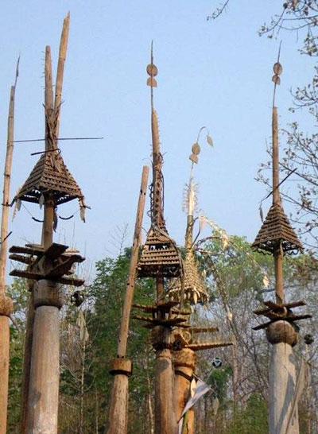
Traditional religion
Kan Khwan
Kayan’s traditional religion is called Kan Khwan, and has been practiced since the people migrated from Mongolia during the Bronze Age.It includes the belief that the Kayan people are the result of a union between a female dragon and a male human/angel hybrid.

Slide 21
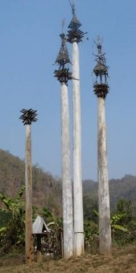
The major religious festival is the 3-day Kay Htein Bo festival, which commemorates the belief that the creator god gave form to the world by planting a small post in the ground. During this festival, held in late March or early April, a Kay Htoe Boe pole is erected and participants dance around the pole.

Slide 22
Kayan food

Slide 25
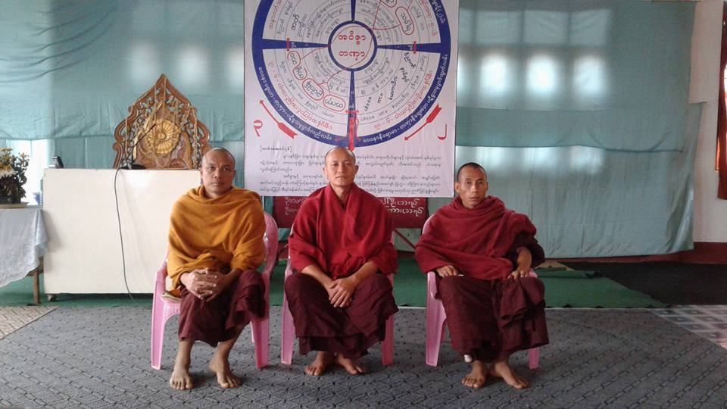
Kayan Buddhism
Tow kinds of education
Pariyatti= Learning the Pali
Patipatti= Practicing Mediation (insight meditation)

Slide 26
Summer Dhamma class

Slide 32
Kayah state
Karenni ( Kayah )State is located in the eastern part of Myanmar. The relief of Karenni ( Kayah ) State is mountainous with the Dawna Range and the Karen Hills also known as "Karenni-Karen" mountains separated by the Salween River as it flows through Karenni ( Kayah ) State. Balu Chaung, flows from Inle Lake flow to Than Lwin River and converge with the Salween in southern Karenni (Kayah) State.

Slide 33
Historical population
Year | Pop. | ±%
1973 | 126,574 | —
1983 | 168,429 | +33.1%
2014 | 286,627 | +70.2%
Source: 2014 Myanmar Census^{[1]}

Slide 34
Ethnic group
Karenni/Kayah(Red people)
2. Padaung(Kayan)
3. Bwe
4. Geba
5. Manumanaw
6. Yantale
7. Zayein (Lahta)
8. Geko
9. Yinbaw
10 Paku (Karen)

Slide 36
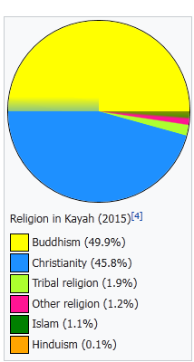
Religion in Kayah state (2015)
Buddhism (49.9%)
Christianity (45.8%)
Tribal religion (1.9%)
Other religion (1.2%)
Islam (1.1%)
Hinduism (0.1%)

Slide 37
Thiri Mingala Hill (Taunggwe) Pagoda - Kayah State It is 387 feet high

Slide 38
Lawpita Hydropower Project

Slide 39
Thank you for your attention!

