Slide 1
Hello all of my lovely brothers
Good atternoon
Very nice to meet you all

Slide 2
Eolithic period
Pleolithic Period Neolithic Period
Post-Lithic Period

Slide 3
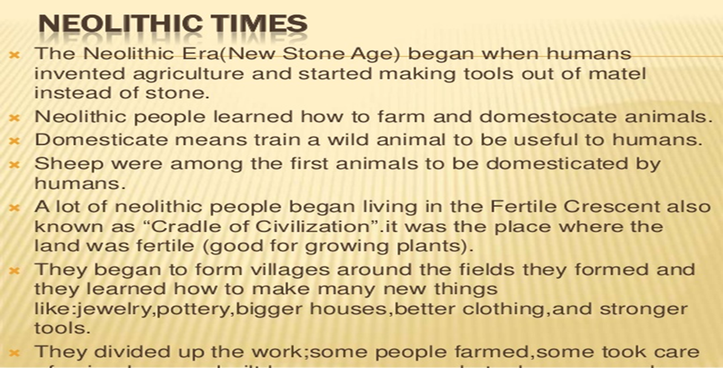

Slide 4
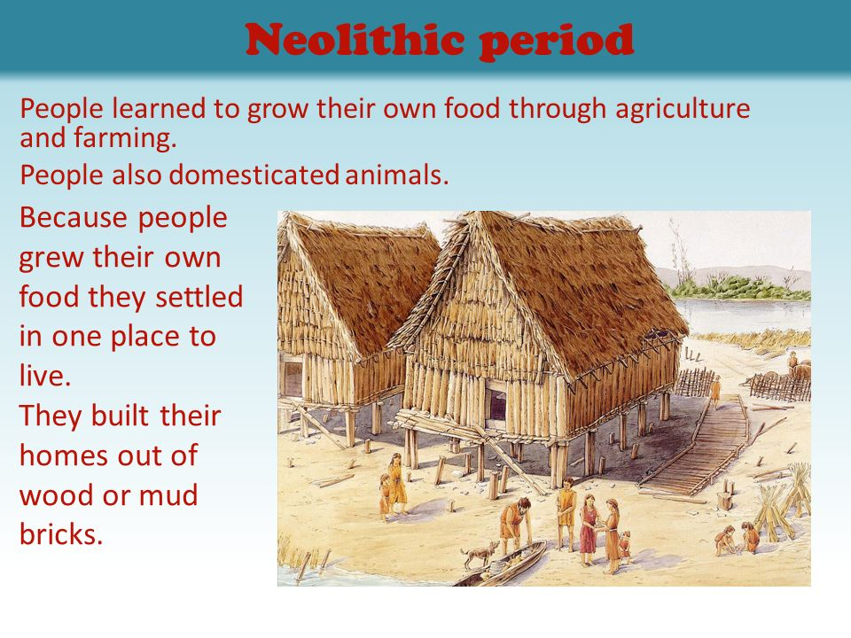

Slide 5
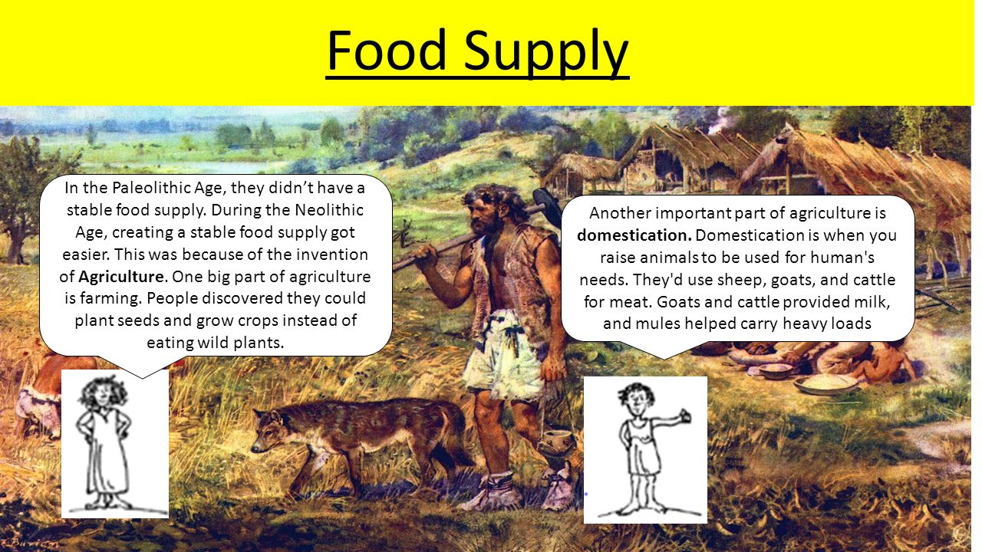

Slide 6
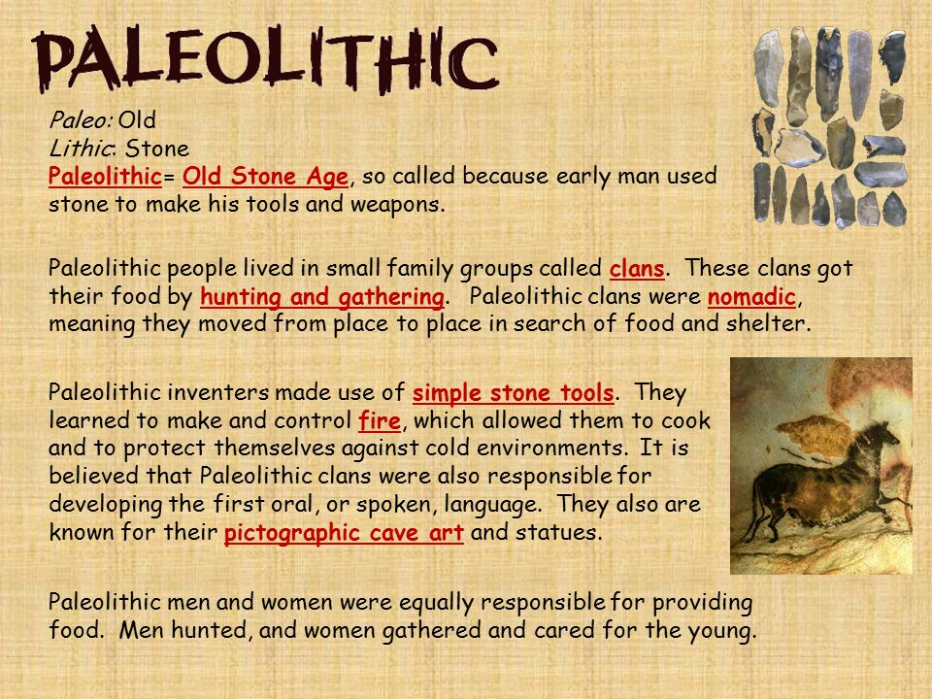

Slide 7
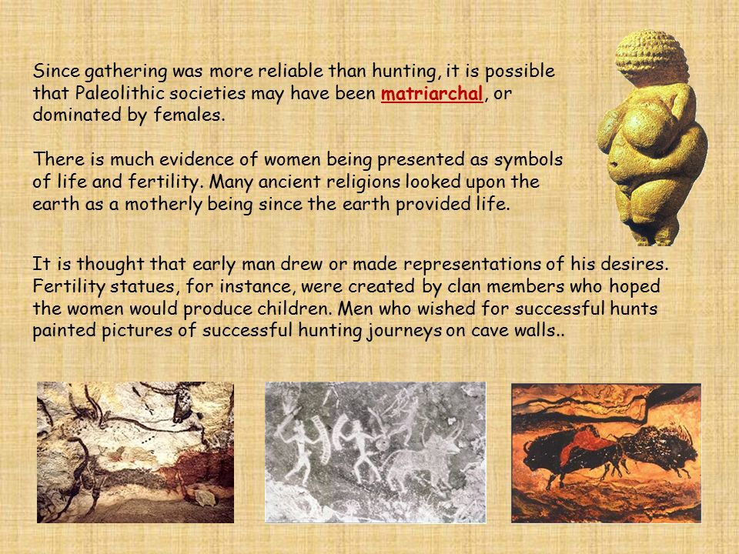

Slide 8
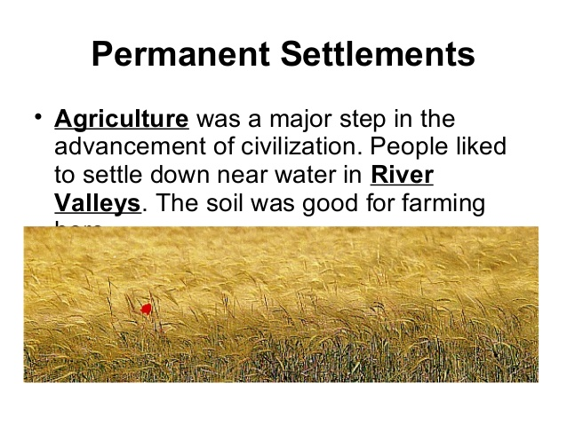

Slide 9
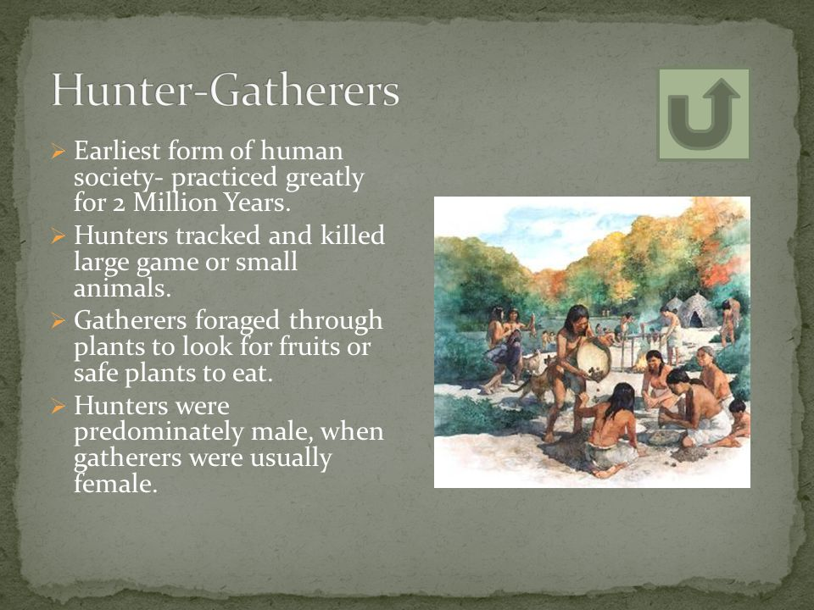

Slide 10
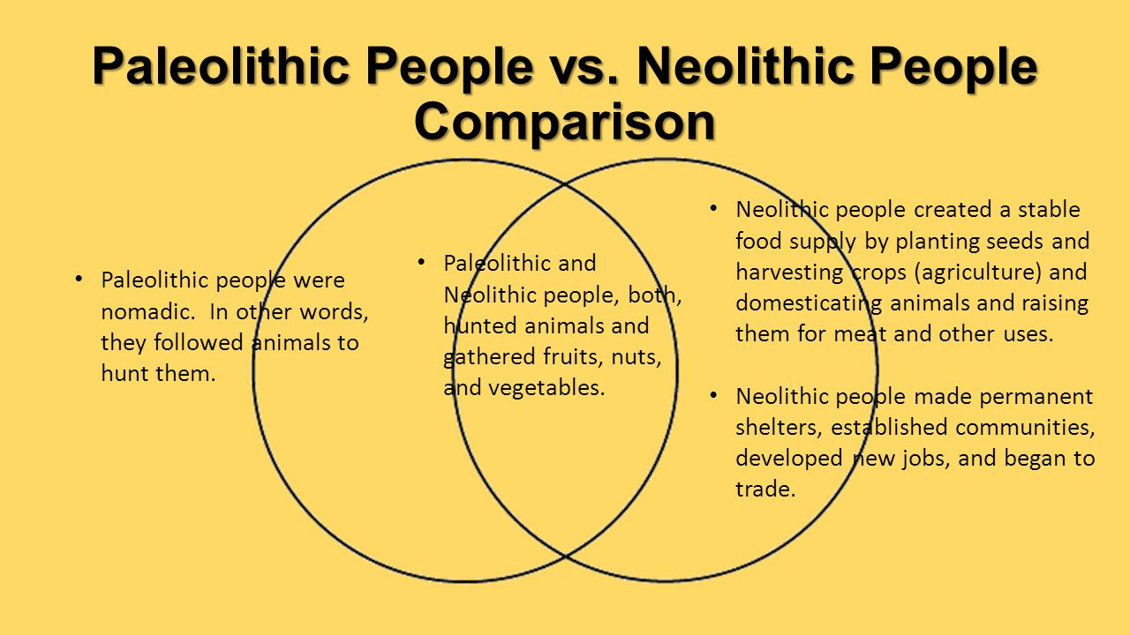

Slide 11
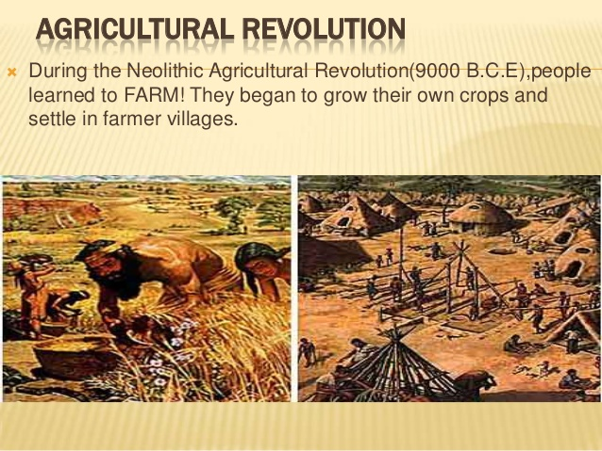

Slide 12
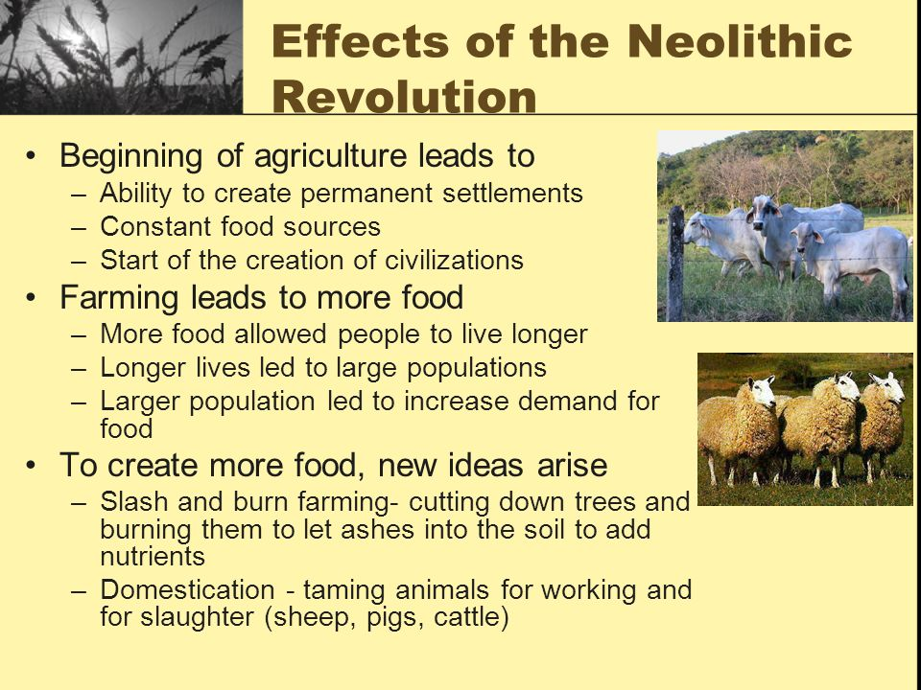

Slide 13
Thanks for your watching

Slide 14
Ven jinobhasa
ID 5901503116

