Slide 1
Buddhist Art in Asia
Lectured by
Ven. Phramaha Somphong Santacitto, Ph.D.

Slide 2
Route of trade and religious dissemination in Asia

Slide 3
Silk road

Slide 4
Indian Buddhism to Asia

Slide 5
Buddhist portable sanctity
Buddha images
Relics
Text
Monk

Slide 6
Questions?
When did the Buddhist art of India spread out to the Northern Asia?
How many categories of Buddhist Art are there in Asia? and so what?
How many periods are there in the Buddhist Art of Northern Asia? and so what?
How is the Buddhist art of Asia in each period?
What are the reasons for creating BA of each school of art?
When, How and which schools of Buddhist Art in India influenced the Himalayas area, China, Korea, Japan, Vietnam, Tibet?

Slide 7
Objectives
To understand Buddhist art and its evolution in Northern Asia.
To understand its impact to others.

Slide 8
Comparative period: Buddhist art of Asia
Country | Schools of art | Locations & Century
Afghanistan | Gandhara art | 1st BCE – 7th Century
Central Asia | Serindian art | 2nd through the 11th century in the Tarim Basin, modern Xinjiang
China | Chinese art | 1st century
Korea | Korea art | 4th century
Japan | Japan art | 6th century
Tibet Bhutan | Tibetan art | 7th century 15th century
Vietnam | Vietnam art South Vietnam | 1st and 9th 15th century

Slide 9
A Northern route was
established from the 1st century CE through Central Asia, Nepal, Tibet, Bhutan, China, Korea, Japan and Vietnam, in which Mahayana Buddhism prevailed.
A Southern route,
where Theravada Buddhism dominated, went through Myanmar, Sri Lanka, Thailand, Cambodia, and Laos, including Malaysia, Indonesia

Slide 10
Buddhist art originated in India in the 6th century BC and and evolved as it came into contact with other cultures in Asia.

Slide 11
Indian Art of Buddhism
Northern Art –
Afghanistan
Central Asia
China
Japan
Korea
Vietnam
Tibet
Bhutan
Southern Art –
Sri Lanka
Cambodia
Myanmar
Thailand
Malaysia
Indonesia

Slide 12
Northern Art –
Afghanistan
Central Asia
China
Japan
Korea
Vietnam
Tibet
Bhutan

Slide 14
Afghanistan
Persisting for several centuries - spread of Islam in the 7th century such as the Buddhas of Bamyan, other sculptures, in stucco, schist or clay, display very strong blending of Indian post-Gupta mannerism and Classical influence, Hellenistic or possibly even Greco-Roman.
Suffering of numerous attacks, which culminated with the systematic destructions by the Taliban regime.
The destruction of the Buddhas of Bamyan, the sculptures of Hadda, and many of the remaining artifacts at the Afghanistan museum.

Slide 15
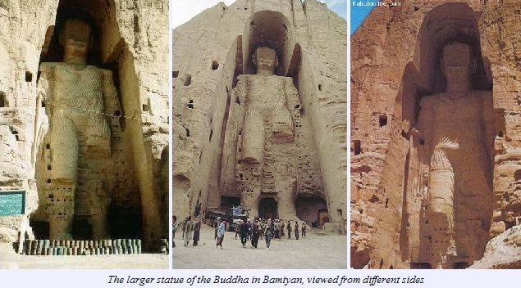
Statue from a Buddhist monastery, 700 AD, Afghanistan
Babiyan Buddha, Afghanistan

Slide 16
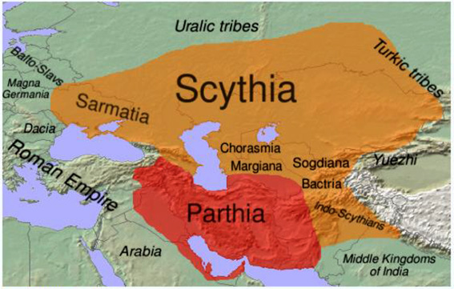

Slide 17
Central Asia
Serindian art, 6th-7th century (wall paintings and reliefs in numerous caves, portable paintings on canvas, sculpture, ritual objects),
Playing the role of a meeting place between China, India and Persia. During the 2nd century BCE,
The expansion of the Former Han to the West led to increased contact with the Hellenistic civilizations of Asia, especially the Greco-Bactrian Kingdom.
The expansion of Buddhism to the North led to the formation of Buddhist communities and even Buddhist kingdoms in the oasis of Central Asia.
Some Silk Road cities consisted almost entirely of Buddhist stupas and monasteries, and it seems that one of their main objectives was to welcome and service travelers between East and West.
Revealing rich Serindian art and its multiple influences from Indian and Hellenistic cultures in the eastern part of Central Asia (Chinese Turkestan (Tarim Basin, Xinjiang)
Finding works of art reminiscent of the Gandharan style, as well as scriptures in the Gandhari script Kharoshti.
These influences were rapidly absorbed however by the vigorous Chinese culture, and a strongly Chinese particularism develops from that point.

Slide 18
Serindian art, 6th-7th century terracotta, Tumshuq (Xinjiang)

Slide 20
CHINA
Cen. | Major Events
67 C.E. | Two Indian Buddhist missionaries are reputed to arrive at the court of Emperor Ming (r. 58–75 C.E.) of the Han dynasty (206 B.C.E.–220 C.E.), where they translate the first Buddhist sutras into Chinese.
148 | The Parthian AN SHIGAO arrives in the Chinese capital of Luoyang; he translates forty-one scriptures of MAINSTREAM BUDDHIST SCHOOLS into Chinese.
366 | Construction of Buddhist cave shrines at DUNHUANG begins.
399 | Chinese scholar–pilgrim FAXIAN (ca. 337–ca. 418) departs for INDIA in search of Buddhist teachings.
401 | KUMA RAJIVA (350–409/413), a Buddhist master from Kucha, arrives in the Chinese capital of Chang’an. He introduces numerous MAHAYANA texts to CHINA.
402 | HUIYUAN (334–416) assembles a group of monks and laymen before an image of the Buddha AMITABHA on Mount Lu and vows to be born in the Western Paradise of Sukhavatl, starting the PURE LAND SCHOOLS of Buddhism.

Slide 21
460 | The Northern Wei (386–534) begins to construct Buddhist cave sanctuaries at YUN’GANG and LONGMEN.
ca. 520 | BODHIDHARMA, putative founder of the CHAN SCHOOL, is reputed to arrive in China from India.
ca. 585 | ZHIYI (538–597) systematizes the TIANTAI SCHOOL of Chinese Buddhism, providing a distinctively Chinese conception of the Buddhist PATH in such texts as the MOHE ZHIGUAN (Great Calmness and Contemplation).
601 | The Sui (581–618) court distributes the Buddha’s relics throughout the country and begins a wave of pagoda construction.
645 | XUANZANG (ca. 600–664) returns from his journey to India with twenty horse-loads of Buddhist texts, images, and relics and begins epic translation project.
699 | FAZANG (643–712) lectures at the Wu Zetian court on the newly translated HUAYAN JING, signaling the prominence of the HUAYAN SCHOOL.
720 | The arrival of Indian masters Vajrabodhi and Amoghavajra in the capital cities of China leads to a surge in popularity of the MIJIAO (ESOTERIC) SCHOOL.
745 | Shenhui (684–758) arrives in the Eastern Capital and propagates the sudden-enlightenment teachings of HUINENG (638–713), the putative sixth patriarch of the CHAN SCHOOL.
845 | Emperor Wuzong (r. 841–847) initiates the Huichang suppression of Buddhism, one of the worst PERSECUTIONS in Chinese Buddhist history.
972 | The Song dynasty initiates a national project to prepare a woodblock printing of the entire Buddhist canon (completed 983).
ca. 1150 | ZONGGAO (1089–1163) formalizes the KOAN system of Chan MEDITATION.

Slide 22
Cen. | Major Events
1270 | The Mongol Yuan dynasty (1234–1368) supports Tibetan Buddhist traditions in China.
ca. 1600 | ZHUHONG (1532–1612) seeks to unify Chan and Pure Land strands of Chinese Buddhism.
1759 | A compendium of Buddhist incantations in Chinese, Manchu, Mongolian, and Tibetan is compiled during the Qianlong reign (1736–1795) of the Manchu Qing dynasty (1644–1911).
1929 | TAIXU (1890–1947) leads the Chinese Buddhist Association as part of his reform of Chinese Buddhist institutions.
1949 | The communist victory in China forces many Buddhist MONKS, such as YINSHUN (1906– ), to flee to TAIWAN.
1965 | The Cultural Revolution is initiated by communist leader Mao Zedong (1893–1976), leading to widespread destruction of Buddhist sites in China.

Slide 23
China
Around the 1st century AD,
Buddhism arrived in China and introduced new types of art into China, particularly in the area of statuary.
Receiving this distant religion, strong Chinese traits were incorporated into Buddhist art.
In the 5th to 6th centuries,
the Northern Dynasties developed rather symbolic and abstract modes of representation, with schematic lines.
Their style: solemn and majestic. The lack of corporeality of this art, and its distance from the original Buddhist objective of expressing the pure ideal of enlightenment in an accessible and realistic manner, progressively led to a change towards more naturalism and realism, leading to the expression of Tang Buddhist art.

Slide 24
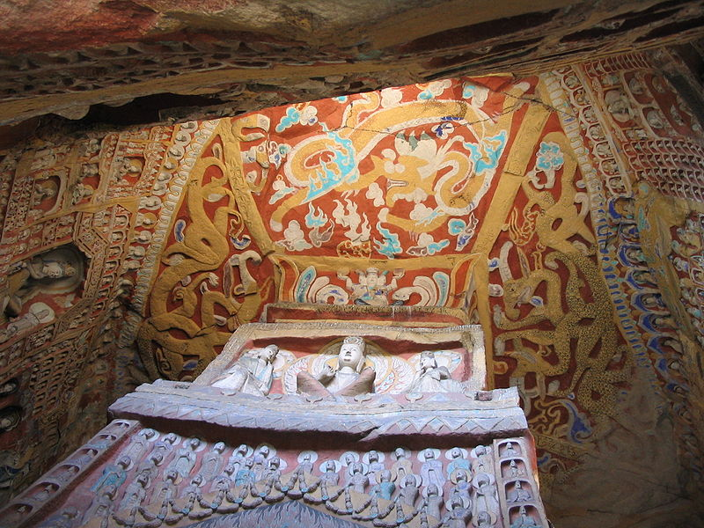
Sites preserving Northern Wei Dynasty Buddhist sculpture: Yungang Grottoes, Shanxi

Slide 25
Longmen Grottoes, Henan

Slide 26
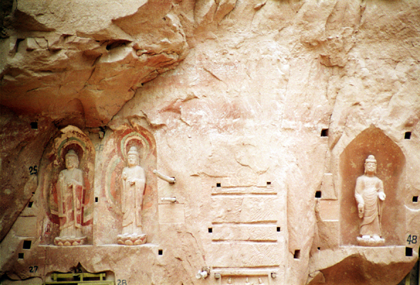
Bingling Temple, Gansu

Slide 28
Japan
From 711, numerous temples and monasteries were built in the capital city of Nara, including a five-story pagoda, the Golden Hall of the Horyuji, and the Kōfuku-ji temple.
Countless paintings and sculptures were made, often under governmental sponsorship. Indian, Hellenistic, Chinese and Korean artistic influences blended into an original style characterized by realism and gracefulness.
The creation of Japanese Buddhist art was especially rich between the 8th and 13th centuries during the periods of Nara, Heian and Kamakura. Japan developed an extremely rich figurative art for the pantheon of Buddhist deities, sometimes combined with Hindu and Shinto influences. This art can be very varied, creative and bold.
From the 12th and 13th, a further development was Zen art, and it faces golden days in Muromachi Period, following the introduction of the faith by Dogen and Eisai upon their return from China.
Zen art is mainly characterized by original paintings (such as sumi-e) and poetry (especially haikus), striving to express the true essence of the world through impressionistic and unadorned "non-dualistic" representations.
The search for enlightenment "in the moment" also led to the development of other important derivative arts such as the Chanoyu tea ceremony or the Ikebana art of flower arrangement. This evolution went as far as considering almost any human activity as an art with a strong spiritual and aesthetic content, first and foremost in those activities related to combat techniques (martial arts).
Buddhism remains very active in Japan to this day. Still around 80,000 Buddhist temples are preserved. Many of them are in wood and are regularly restored.

Slide 29
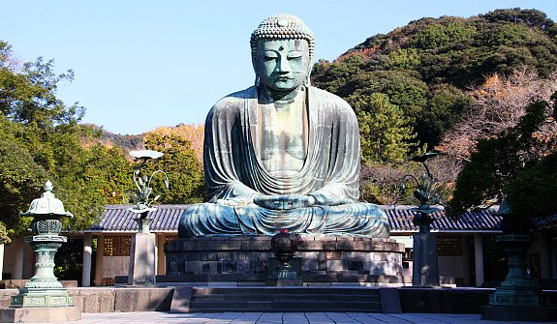
Scroll calligraphy of Bodhidharma "Zen points directly to the human heart, see into your nature and become Buddha", by Hakuin Ekaku (1686 to 1769)
Amida Buddha, Kōtoku-in
The Great Buddha, Kamakura

Slide 31
Korea
Combination of different regional styles together to create a specific Korean Buddhist art style.
Reflecting an interaction between other Buddhist influences and a strongly original Korean culture. Additionally, the art of the steppes, particularly Siberian and Scythian influences, are evident in early Korean Buddhist art based on the excavation of artifacts and burial goods such as Silla royal crowns, belt buckles, daggers, and comma-shaped gogok. The first of the Three Kingdoms of Korea to officially receive Buddhism was Goguryeo in 372.
Chinese records and the use of Buddhist motifs in Goguryeo murals indicate the introduction of Buddhism earlier than the official date
The Baekje Kingdom officially recognized Buddhism in 384.
The Silla Kingdom, isolated and with no easy sea or land access to China, officially adopted Buddhism in 535 although the foreign religion was known in the kingdom due to the work of Goguryeo monks since the early 5th century.
The introduction of Buddhism stimulated the need for artisans to create images for veneration, architects for temples, and the literate for the Buddhist sutras and transformed Korean civilization.
Particularly important in the transmission of sophisticated art styles to the Korean kingdoms was the art of the "barbarian" Tuoba, a clan of non-Han Chinese Xianbei people who established the Northern Wei Dynasty in China in 386.
The Northern Wei style was particularly influential in the art of the Goguryeo and Baekje. Baekje artisans later transmitted this style along with Southern Dynasty elements and distinct Korean elements to Japan. Korean artisans were highly selective of the styles they incorporated

Slide 32
During the Unified Silla period, East Asia was particularly stable with China and Korea both enjoying unified governments.
Early Unified Silla art combined Silla styles and Baekje styles. Korean Buddhist art was also influenced by new Tang Dynasty styles as evidenced by a new popular Buddhist motif with full-faced Buddha sculptures.
Tang China was the cross roads of East, Central, and South Asia and so the Buddhist art of this time period exhibit the so-called international style. State-sponsored Buddhist art flourished during this period, the epitome of which is the Seokguram Grotto.
Goryeo Dynasty
The fall of the Unified Silla Dynasty and the establishment of the Goryeo Dynasty in 918 indicates a new period of Korean Buddhist art. The Goryeo kings also lavishly sponsored Buddhism and Buddhist art flourished, especially Buddhist paintings and illuminated sutras written in gold and silver ink. [3]. The crowning achievement of this period is the carving of approximately 80,000 woodblocks of the Tripitaka Koreana which was done twice.
Joseon Dynasty
The Joseon Dynasty actively suppressed Buddhism beginning in 1406 and Buddhist temples and art production subsequently decline in quality in quantity although beginning in 1549, Buddhist art does continue to be produced.

Slide 33
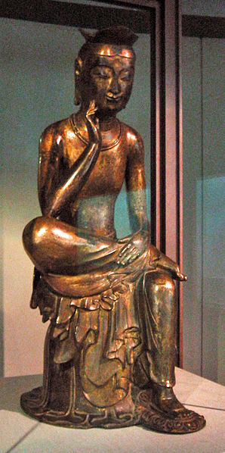
Seokguram Grotto is a World Heritage Site and dates to the Unified Silla era.
Bangasayusang, semi-seated contemplative Maitreya probably from Silla circa early 7th century.

Slide 34
Standing Yakusa Korea; 8th century, Unified Silla Period, Bronze Brooklyn Museum, Frank L. Babbott Fund, 74.165

Slide 35
Vietnam
Chinese influence was predominant in the north of Vietnam (Tonkin) between the 1st and 9th centuries, and Confucianism and Mahayana Buddhism were prevalent.
Overall, the art of Vietnam has been strongly influenced by Chinese Buddhist art.
In the south thrived the former kingdom of Champa (before it was later overtaken by the Vietnamese from the north).
Champa had a strongly Indianized art, just as neighboring Cambodia.
Many of its statues were characterized by rich body adornments. The capital of the kingdom of Champa was annexed by Vietnam in 1471, and it totally collapsed in the 1720s, while Cham people remain an abundant minority across Southeast Asia.

Slide 36
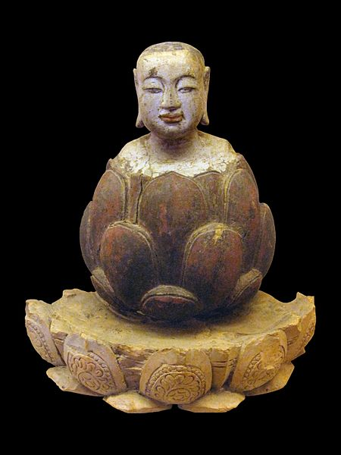
The boy Buddha rising up from lotus. Crimson and gilded wood, Trần-Hồ dynasty, Vietnam, 14th-15th century

Slide 39
Tibet-Bhutan
Tantric Buddhism started as a movement in eastern India around the 5th or the 6th century.
Many of the practices of Tantric Buddhism are derived from Brahmanism (the usage of mantras, yoga, or the burning of sacrificial offerings). Tantrism became the dominant form of Buddhism in Tibet from the 8th century.
Due to its geographical centrality in Asia, Tibetan Buddhist art received influence from Indian, Nepali, Greco-Buddhist and Chinese art.
One of the most characteristic creations of Tibetan Buddhist art are the mandalas, diagrams of a "divine temple" made of a circle enclosing a square, the purpose of which is to help Buddhist devotees focus their attention through meditation and follow the path to the central image of the Buddha.
Artistically, Buddhist Gupta art and Hindu art tend to be the two strongest inspirations of Tibetan art.

Slide 40
Tibetan art refers to the art of Tibet. For more than a thousand years, Tibetan artists have played a key role in the cultural life of Tibet.
From designs for painted furniture to elaborate murals in religious buildings, their efforts have permeated virtually every facet of life on the Tibetan plateau.
The vast majority of surviving artworks created before the mid-20th century are dedicated to the depiction of religious subjects, for the most part being distemper on cloth or murals.
They were commissioned by religious establishments or by pious individuals for use within the practice of Tibetan Buddhism and were manufactured in large workshops by uncredited artists.
The art of Tibet may be studied in terms of influences which have contributed to it over the centuries, from other Chinese, Nepalese, Indian, and sacred styles.
Mahayana Buddhist influence
Tantric influence
Bön influence

Slide 41
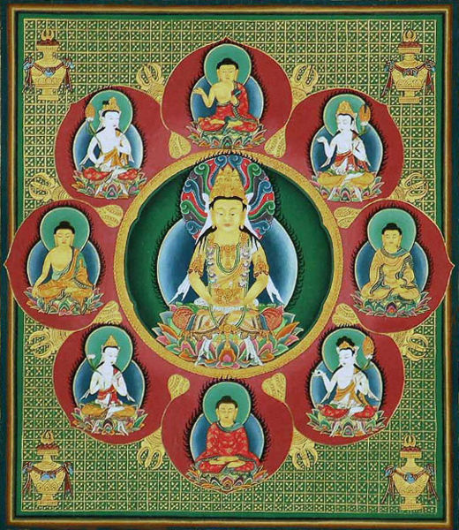
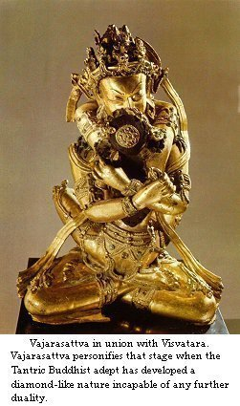
Detail of the Vajrayana mandala shown above. This is a Garbhadhatu mandala, representing Vairocana Buddha surrounded by eight Buddhas and bodhisattvas (clockwise from top: Ratnaketu, Samantabhadra, Samkusumitaraja, Manjusri, Amitabha, Avalokitesvara, Dundubhinirghosa, Maitreya).

Slide 43
Conclusion
Buddhist art continued to develop in India for a few more centuries. The pink sandstone sculptures of Mathura evolved during the Gupta period (4th to 6th century) to reach a very high fineness of execution and delicacy in the modeling. The art of the Gupta school was extremely influential almost everywhere in the rest of Asia. By the 10th century, Buddhist art creation was dying out in India, as Hinduism and Islam ultimately prevailed. At the end of the 12th century A.D. Buddhism in its full glory came to be preserved only in the Himalayan regions in India. These areas, helped by their location, were in greater contact with Tibet and China - for example the art and traditions of Ladakh bear the stamp of Tibetan and Chinese influence.
As Buddhism expanded outside of India from the 1st century AD, its original artistic package blended with other artistic influences, leading to a progressive differentiation among the countries adopting the faith.
A Northern route was established from the 1st century CE through Central Asia, Nepal, Tibet, Bhutan, China, Korea, Japan and Vietnam, in which Mahayana Buddhism prevailed.
A Southern route, where Theravada Buddhism dominated, went through Myanmar, Sri Lanka, Thailand, Cambodia, and Laos.

Slide 44
http://en.wikipedia.org/wiki/Buddhist_art

