Slide 1
Buddhist Art Sculpture – Buddha How to create buddha
Lectured by
Ven. Phramaha Somphong Santacitto, Ph.D.

Slide 2
Three types of Arts
Sculpture
Architecture
Fine arts

Slide 3
Sculpture
Symbolism of sculpture is idolatry, carving, molding representing or symbolizing holy religious objects
Three categories
Deities/ gods
Religious founder, prophet and his contemporary disciples
Potency or authority of God (Sakti)

Slide 4
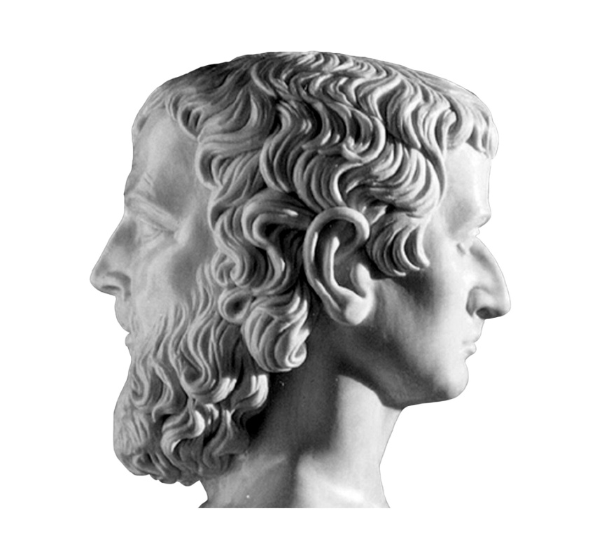
1. Deities/ gods

Slide 5
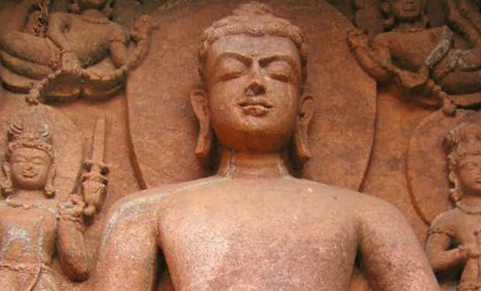
3. Religious founder, prophet and his contemporary disciples

Slide 6
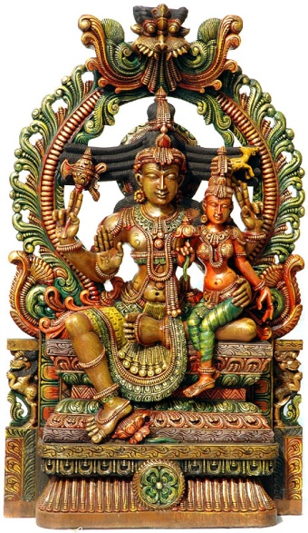
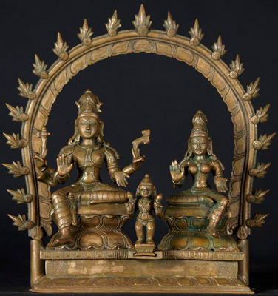
3. Potency or authority of God (Sakti)

Slide 7
Why the sculpture of buddha was created?
Arising of Mahayana
Buddha more emphasized according to Buddhacarita, Lalivata.
Cultural interaction
Greek/Roman influence.

Slide 8
Buddha and his related objects
Buddha
Bodhisattva
Disciples
Footprint
Throne
Bodhi tree
Dhammacakra wheel

Slide 9
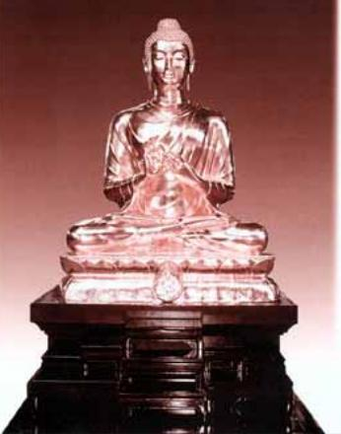
How to cast the Buddhacarka

Slide 10
A case study of a Phra Buddha Dhammacakra image
There are three main steps in the process of casting a Buddha statue:
Sculpturing a clay mould,
Sculpturing a beeswax mould
Metal (gold) casting.

Slide 11
Step 1: Sculpturing a clay mould
This step begins with drawing the figure of the Buddha image on the paper to calculate the size of the image and to find the position to put the supporting steel. Then the sculptor sketches the three-dimensional model using plasticine and expands the model to the desired size. The size of the image, or in this case a Phra Buddha Dhammacakra image, is double the size of an ordinary person, using the ratio of 1:10 from the original model.
The ancient technique of making the Buddha image uses natural clay to build a clay mould. If the sculptors want the mould to be durable and long lasting, they will mix the clay with straw paper or bark paper. In Thailand, the best quality clay for sculpturing the clay mould is the clay from Sarmkok area in Pathumthani province.

Slide 12
To prepare the clay for sculpturing the Buddha image, the sculptors pound the clay and put it in water.
Then the clay is mixed with sifted sand and water in the appropriate ratio. The typical ratio of the mixture of sifted sand and clay is 5:1 (5 portions of sifted sand to 1 portion of clay), 3:2, or 2:1 depending on the quality of the clay (normal ratio is 5:1). After that the mixture of clay and sifted sand is ground or stepped on to make the complete mixture of the ingredients. Then the sculptor builds the supporting steel structure by putting the cross-shape iron core inside the clay mould in order to make a rough-hewn model and leaving it for seven days before moving to the moulding stage [Fig. 1].
In the moulding stage, the sculptor uses the prepared clay to mould on the rough-hewn model.
This stage requires skilful sculptors, who really understand and put their soul in the artwork in order to create a beautiful, elegant, and delicate work. The last stage in the first step of clay moulding is to refine on all the detail of the mould. Then the sculptor will spray water on the mould and cover it with wet cloth and plastic to protect the mould from getting dry. This step of building a clay mould normally takes at least one and a half to two months.

Slide 13
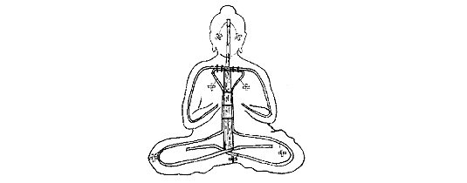
Sculpturing a clay mold showing anatomy

Slide 14
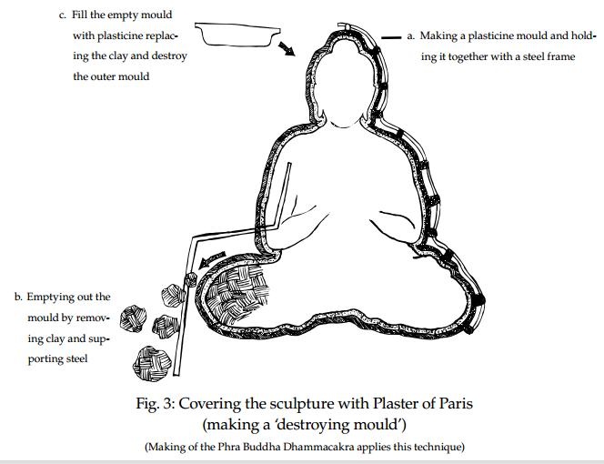
A Clay Mould of Buddha Dhammacakra

Slide 15
Step 2: Sculpturing a beeswax mould
There are two different techniques of sculpturing a beeswax mould: "Piece mould" and "Destroying mould".
In the creation of Phra Buddha Dhammacakra image the sculptors applied the latter method i.e. 'destroying mould' and the following are the detail of the process of making a 'destroying mould.'
2.1 Specifying the position to divide the mould into two parts and having the opening part, where the sculptor can use to remove the clay from the mould.
2.2 Putting the thin zinc sheet, cut in a small rectangular shape, in the specified position (from Step 2.1) on the mould and coating with plaster of Paris. Then the sculptor will put another layer of plaster of Paris to the line of the zinc sheet and put the steel rod to strengthen the plaster mould. After that the sculptor will put the cement mixed with coconut fibre at the connection line of the steel. After the cement congeals, the sculptor will remove the clay and the supporting steel from the mould and use wet sponge to clean the plaster of Paris mould [Fig. 2].
2.3 Laying down the mould, using bricks to support the mould, and applying the clay water and liquid soap on the mould. Then the sculptor will use brush to dry the mould.
2.4 Followed by pouring the beeswax into the mould and putting the mould on the smooth material. Then the sculptor will fill the core of the mould with the plaster-cement mixed with the sand and leave it for one day. When the cement congeals, the sculptor will remove the cement mould block and get the beeswax mould. [Fig. 4].
2.5 Refining the beeswax mould. This stage needs a delicate work to make the beeswax mould beautiful and resemble the original model. The more beautiful and delicate work of this stage, the nicer the final result will be.
2.6 Making the drain for releasing the beeswax and to be the point for filling in the liquid metal.

Slide 16
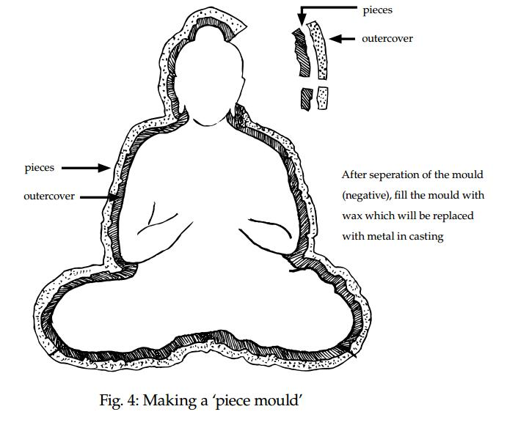
Making a piece mould

Slide 17
Step 3: Metal (gold) Casting
The metal that is commonly used in this step of casting is brass, copper, or bronze. The sculptor melts the metal and pours it in the mould. This casting step is normally called in Thai gold pouring. Generally, the casting is done with a religious ceremony. The following are the summary of the process of casting the image or the process of gold pouring.
3.1 Moving the beeswax mould to the gold pouring area and making the kiln by digging a hole around 70 centimetres depth. Then the sculptor will put the beeswax mould in the hole in an upside-down position, open two sides of the kiln and close the top part of the kiln with a zinc sheet to control the fire.
3.2 Before the brass is poured, the mould is baked. The wax layer inside will melt and flow out of the mould, leaving the shape of the Buddha's image inside the mould. This stage is called emptying the beeswax. [Fig. 5 ].After the beeswax is removed, the area inside the mould block is empty and will be replaced by the liquid metal[Fig. 6 ].
3.3 Melting the metal. To melt the metal for casting the image, the sculptors made four kilns and prepare the fire that can be controlled in the levels of heat from 100-200 Celsius (to melt the beeswax) and to 1500-1800 Celsius (for brass pouring). This stage of baking takes around 3-4 days.

Slide 18
3.4 The amount of the required metal can be estimated from the amount of beeswax used in Step 2 because the liquid metal will replace the beeswax in the mould block. Normally one kilogram of beeswax is replaced by 100 grams of brass or more than 100 grams for copper. Moreover, the amount of required beeswax and metal can be used to estimate the amount of required fuel. The time needed to melt the metal is around 8-12 hours.
3.5 After the bronze cools down (taking around 2-3 days), the craftsman knocks the outer cement layers and supporting steel off to reveal a bronze statue, which looks exactly like the wax replica.
3.6 Gold gilding is the last stage in casting a Buddha image:
3.6.1 Clean the image; polish it with sandpaper around 2 to 3 times, leave it dry, and coat it with lacquer.
3.6.2 Spray colour on the image, leave it dry, refine it with plastic colour and leave it dry for two days.
3.6.3 Polish the image with fine wet sandpaper and leave it dry. These steps need repeating to get a fine finish product.
3.6.5 At the final stage, the image is painted with oil paint on the assigned area, leave it to dry (around 5-6 hours), gild it with 100% gold leaf, and wipe it with cotton. This gives a perfect golden Buddha image ready for placement in temples or religious places. However, to make it sacred and a religious object of veneration there will be a consecration ceremony of the Buddha after the placement of the Buddha at its place.

Slide 19
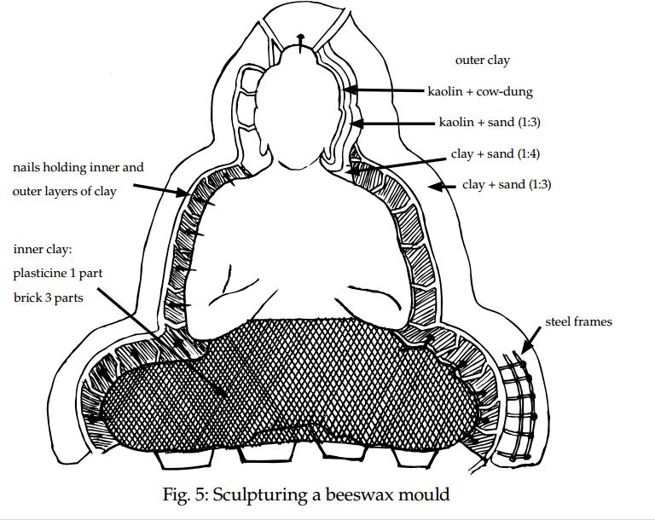
Sculpturing a beeswax mould

Slide 20
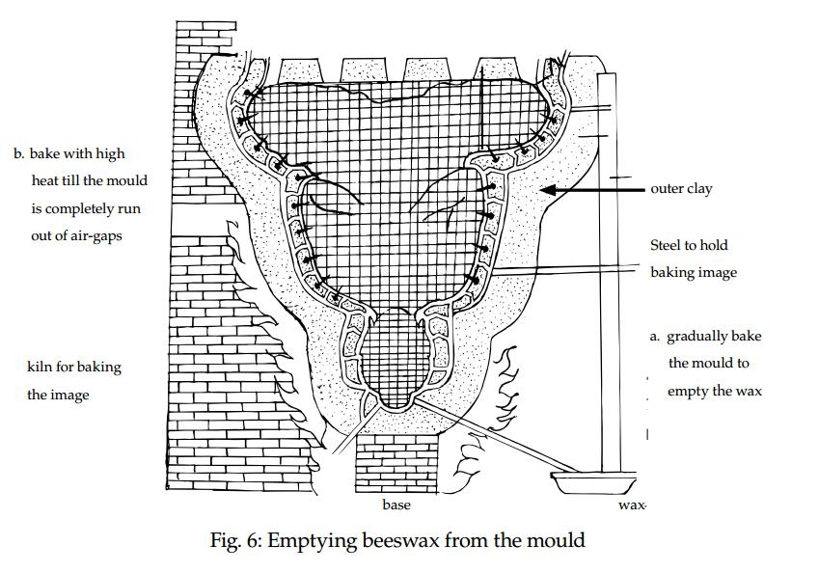
Emptying beeswax from the mould

Slide 21
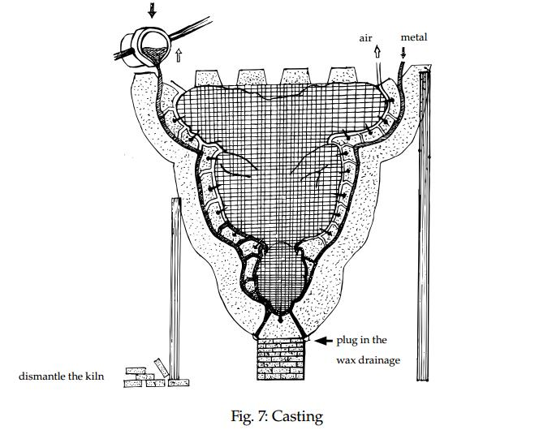
casting

Slide 22
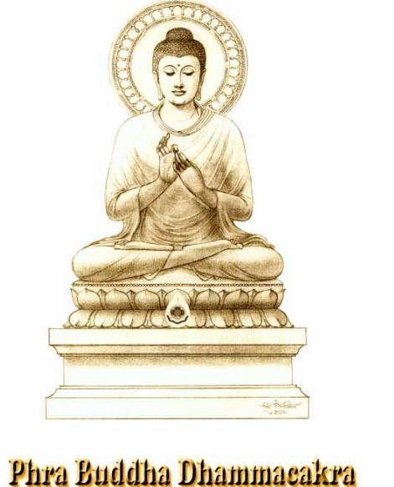

Slide 24
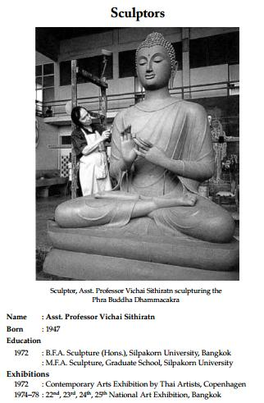
Sculptor

