Slide 1
Buddhist Art Sculpture – Buddha Mudra – Hand gesture
Lectured by
Ven. Phramaha Somphong Santacitto, Ph.D.

Slide 2
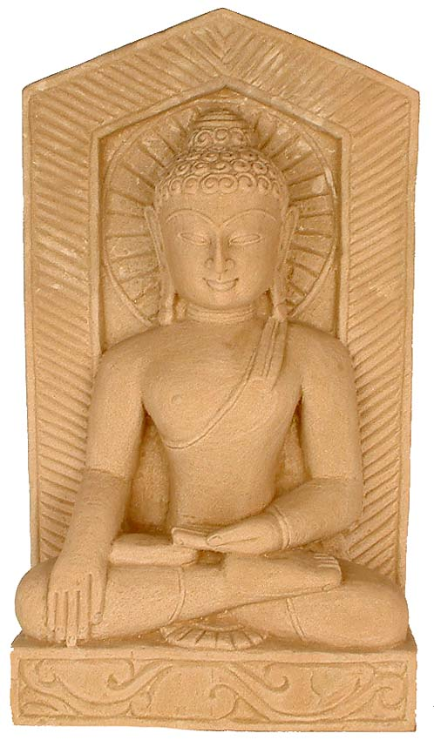
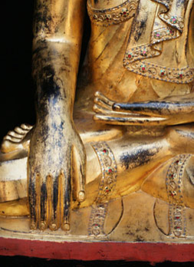

Slide 3
Buddha and his related objects
Buddha
Bodhisattva
Disciples
Depictions of the Buddha (Aniconic symbols)
Footprint
Dhammacakra wheel
Wheel
Pillar
Fiery energy portrayed as a halo or aureole
An umbrealla (usually with multiple tiers
Lotus
Stupa
Throne
Bodhi tree

Slide 4
A set standardized similes by Indian poets
An Oval head ‘shaped like an egg’ or ‘like the fruit of the Indian bael tree’
Arched eyebrow ‘like drawn bows’
Aquiline nose ‘like a parrot’s beak’
Chin ‘like a mango stone’ (often incise with an elliptical line)
Shoulders ‘like an elephant’s head’
Arms as sinuous ‘as an elephant’s trunk’
Hands ‘like lotus flowers just beginning to open’
No display of bones, muscles or veins’

Slide 5
Hand Mudras - Symbols of Deeper Meaning
The symbolic gestures of the hands of Buddha images, called mudras, are picture tools of identification of deeper meaning:
These various Buddhist hand positions are called Mudras and are thousands of years old. The various body postures, hand positionsand leg positions have different symbolic meanings, each of considerable importance to students of Buddha.

Slide 6
Indian context
The term ‘hasta’ or ‘hattha’ meaning hand or forearm) for Brahmanic iconography.
‘mudra’ meaning a mark or seal for Buddhist iconography.

Slide 7
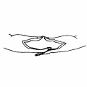
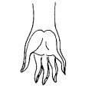
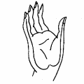
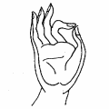
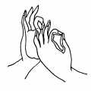
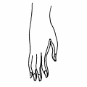
Six Mudra (hand gesture) specifically used for the buddha
Dhyana mudra: signifying meditation.
Varada mudra: signifying charity, gifts or favours.
Abhaya mudra: signifying absence of fear (bhaya means ‘fear, terror or peril’ ‘a’ is a privative prefix) dispelling fear.
Vitarka mudra: meaning reasoning and exposition.
Dharmacakra mudra (dhammacakra pravartana mudra): meaning ‘setting the wheel of the law in motion’.
Bhumisparsa mudra: signifying ‘touching the earth’

Slide 8
1. Dhyana Mudra
This mudra signifies meditation. Both hands are in the lap with palms upward. The right hand is on top of the left hand. The Buddha is most seated in the half-lotus posture (sometimes called 'yoga', 'Indian', 'Buddha' posture). Some images display the Buddha in the so-called adamantine (diamond, or full-lotus) posture with tightly crossed legs, so that the soles of both feet are visible.
The Bodhisattva makes a vow and is determined not the leave the spot (where he is sitting on the grass) until he achieves enlightenment. The Boddhisattva determines to find the cause of suffering and its cessation.

Slide 9
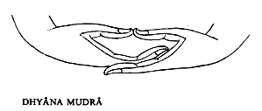
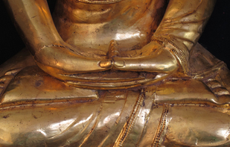
The Gesture of Meditation (Samadhi Mudra) with both hands resting on the lap, palms upwards.

Slide 10
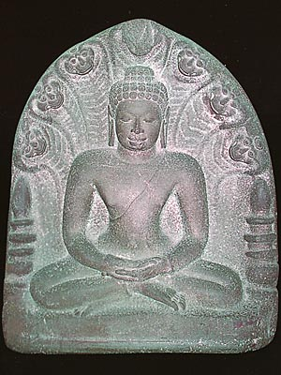
Dvaravati art - Buddha, protected by Naga in meditation posture. 8 - 11 th century A.D. Found at Si Mahosot, Prachinburi province. Now in the National Museum, Bangkok.

Slide 11
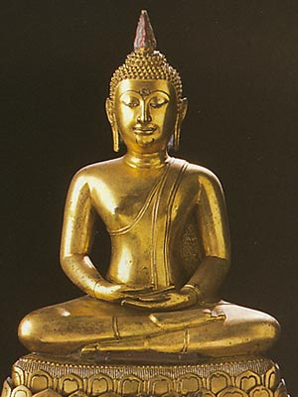
Meditating Sitting in the yoga posture. Note the right leg on top of the left, the right hand on top of the left hand. Buddha image presently at Phra Pathom Chedi.

Slide 12
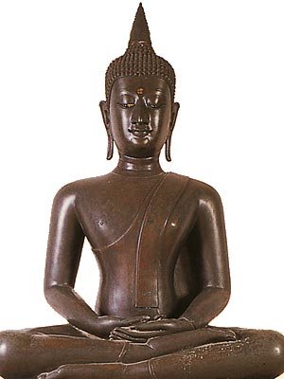
Sitting Buddha image, with the gesture of Meditation. In the style of the Chiang Saen period. Found at Chiang Saen, Chiang Rai province. Image present in the cloister of the Ubosoth at Wat Benchamabophit, Bangkok.

Slide 13
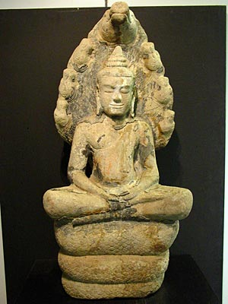
Buddha in Meditation, sheltered by Naga. Khmer art, Bayon Style (1177-1230 A.D.) National Museum Prachinburi

Slide 14
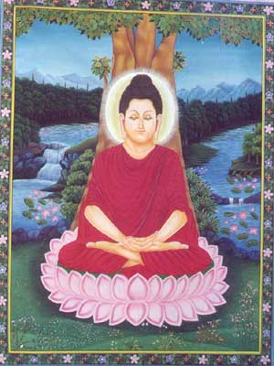
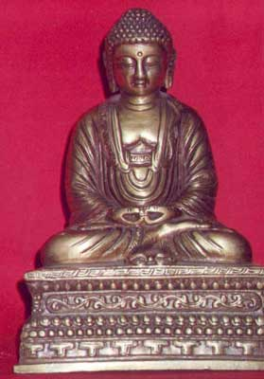
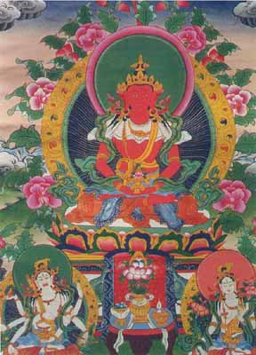
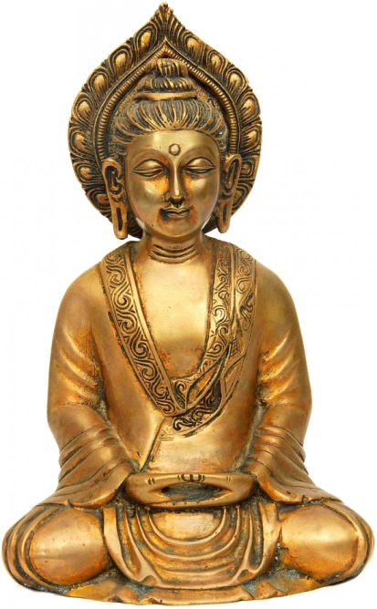
This mudra is displayed by the fourth Dhyani Buddha Amitabha, also known as Amitayus. By meditating on him, the delusion of attachment becomes the wisdom of discernment. The Dhyana mudra helps mortals achieve this transformation.

Slide 15
2. Bhumisparsa Mudra :
Subduing Mara, Calling the Earth to Witness. The left hand lies in the lap, palm upward. The right hand bends over the right knee, with fingers slightly touching the ground. During meditation, Siddhartha is subjected to many temptations many posed by the evil Mara, who bombards him with his demons , monsters, violent storms and his three seductive daughters. The Buddha remains steadfast. Then to testify to Mara of his meritorious past, he points to the earth with his hand and calls the Earth Goddess. Thorani, the Earth Goddess rises from the ground and wrings the water from her long black hair, by this action raising a torrential flood that drowns Mara and his army of demons. This gesture symbolizes enlightenment, as well as steadfastness (imperturbability). It is easily the most common Buddha gesture in Thai wats.

Slide 16
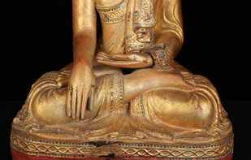
Bhumisparsa Mudra Touching the earth as Gautama did, to invoke the earth as witness to the truth of his words.

Slide 17
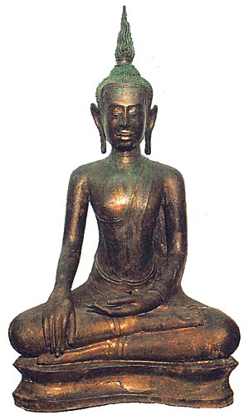
Bronze Buddha Subduing Mara 2nd period of U-Thong Style, 15th Century From Wat Mahathat ,Sukhothai Presently at Ramkhamhaeng National Museum, Sukhothai

Slide 18
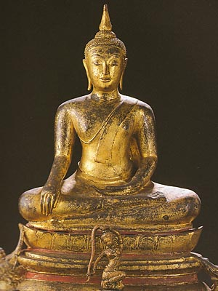
Subduing Mara - Calling the Earth to Witness [the most common representation of the Buddha in Thailand] The left hand rests on the lap, the right hand points to the ground, slightly touching it. Mara (representing evil) and his horde offer all kinds of earthly 'pleasures' such as riches, power, women. However, the Bodhisattva scorns it all, and continues to contemplate. Buddha image presently at Phra Pathom Chedi.

Slide 19
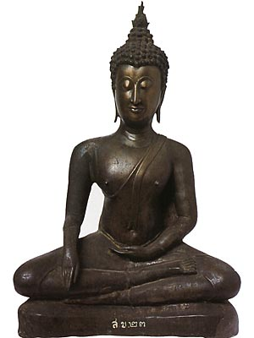
Buddha Image with the Gesture of Subduing Mara. (15th century A.D.) National Museum Prachinburi

Slide 20
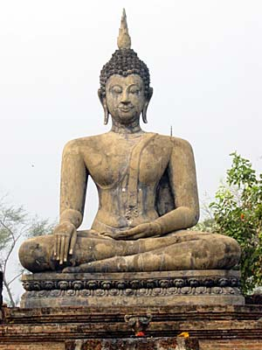
Buddha at Wat Mahathat, Sukhothai Historical Park.

Slide 21
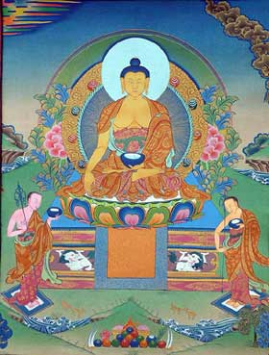
Literally Bhumisparsha translates into 'touching the earth'. It is more commonly known as the 'earth witness' mudra. This mudra, formed with all five fingers of the right hand extended to touch the ground, symbolizes the Buddha's enlightenment under the bodhi tree, when he summoned the earth goddess, Sthavara, to bear witness to his attainment of enlightenment. The right hand, placed upon the right knee in earth-pressing mudra, and complemented by the left hand-which is held flat in the lap in the dhyana mudra of meditation, symbolizes the union of method and wisdom, samasara and nirvana, and also the realizations of the conventional and ultimate truths. It is in this posture that Shakyamuni overcame the obstructions of Mara while meditating on Truth.
The second Dhyani Buddha Akshobhya is depicted in this mudra. He is believed to transform the delusion of anger into mirror-like wisdom. It is this metamorphosis that the Bhumisparsha mudra helps in bringing about.

Slide 22
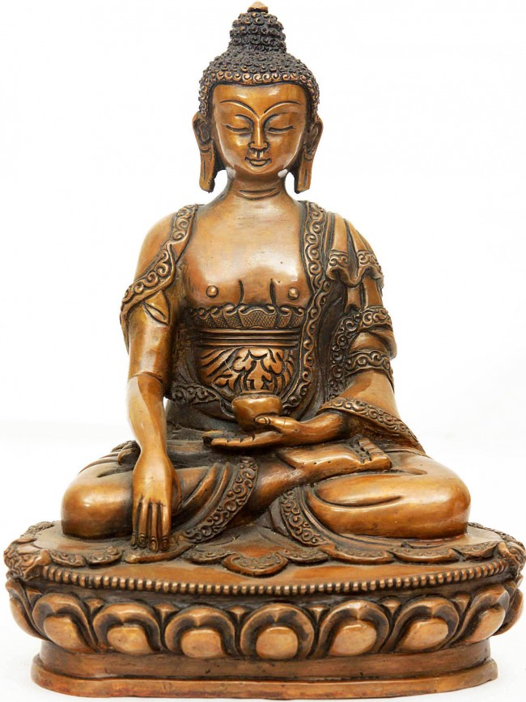
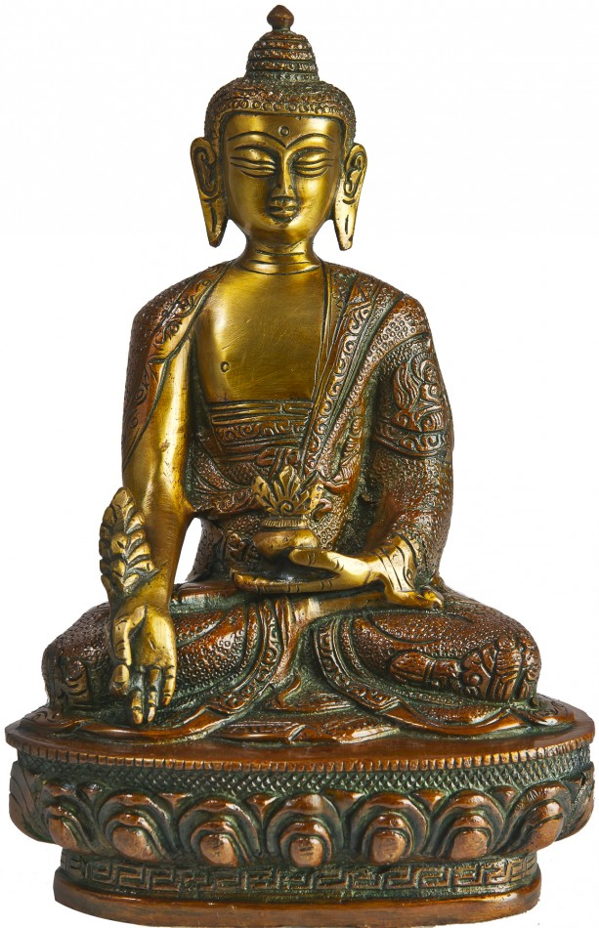
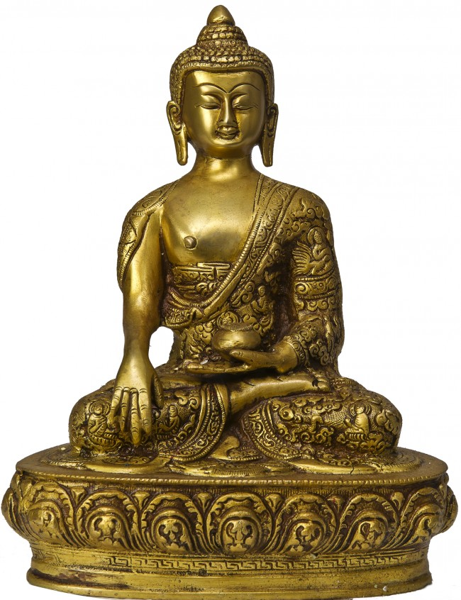

Slide 23
3. Abhaya Mudra:
Imparting Fearlessness (Reassurance). This gesture is made with the hand raised and the palm facing outwards, fingers extended pointing upward. The wrist is bent at a right angle with the forearm. The gesture is sometimes made with both hands. Sometimes the Abhaya Mudra is made with one hand, while another Mudra (such as Varuda Mudra) is made with the other hand. The Buddha may be either standing, sitting or walking.

Slide 24
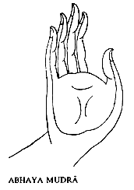
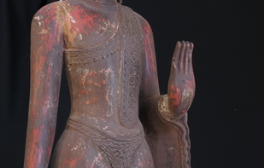
The Gesture of Fearlessness (Abhaya Mudra) the right hand slightly elevated, the palm turned outwards, also called the Gesture of Renunciation.

Slide 25
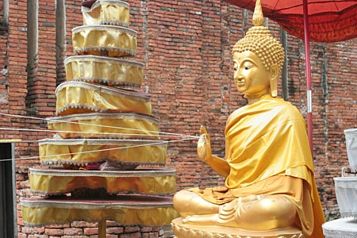
Seated Buddha Image, displaying the Hand Gesture of Abhaya Mudra. The Buddha Image is holding threads connected to various parts of the Ubosoth (part of religious ceromony) at Wat Thammikarat, Ayutthaya.

Slide 26
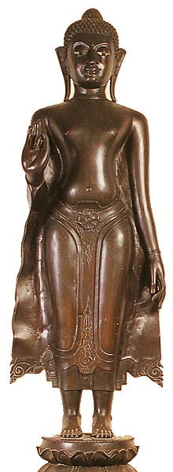
Standing Buddha image, with the gesture of Forbidding the Relatives from Fighting. In the style of the Lopburi period. Cast and enlarged from an ancient model. Image present in the cloister of the Ubosoth at Wat Benchamabophit, Bangkok.

Slide 27
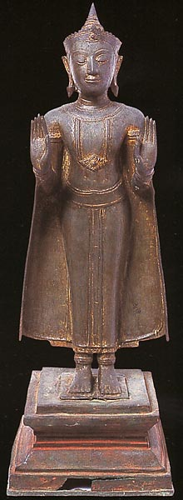
Standing Buddha image with the Gesture of Calming the Ocean. Ayutthaya Style. The Buddha is in Royal Attire. (16-17th Century A.D.) National Museum Prachinburi

Slide 28
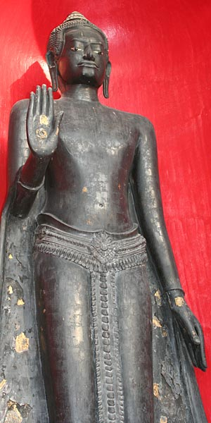
Standing Buddha image, with the gesture of Forbidding the Relatives from Fighting. Wearing the attributes of Royalty. In the style of the Lopburi period. From Wat Tewarat, Bangkok. Image present in the courtyard behind the Ubosoth at Wat Benchamabophit, Bangkok.

Slide 29
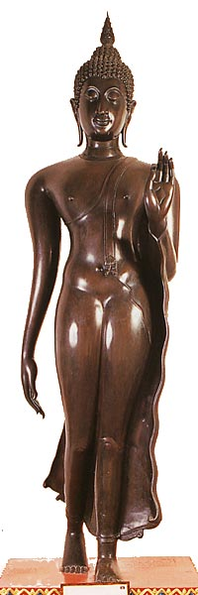
Walking Buddha image with the gesture of Imparting Fearlessness. In the style of the Sukhothai period. From Wat Mahathat, Bangkok. Image present in the cloister of the Ubosoth at Wat Benchamabophit, Bangkok.

Slide 30
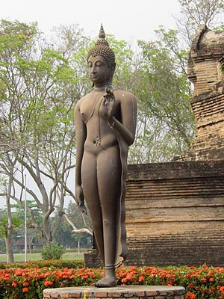
Walking Buddha, Sukhothai Historical Park

Slide 31
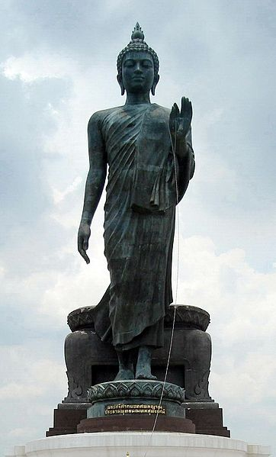
Statue of the Buddha with his hand upraised in the abhāya mudrā position. He is draped with monastic robes, with the right shoulder bare. (Phutthamonthon, Thailand)

Slide 32
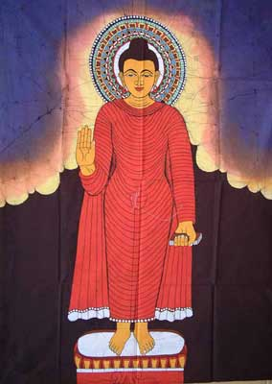
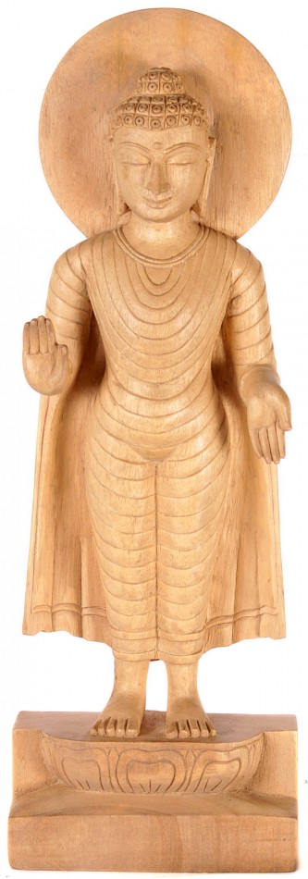
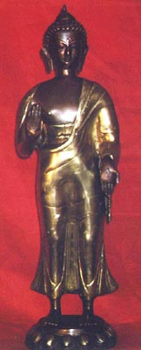
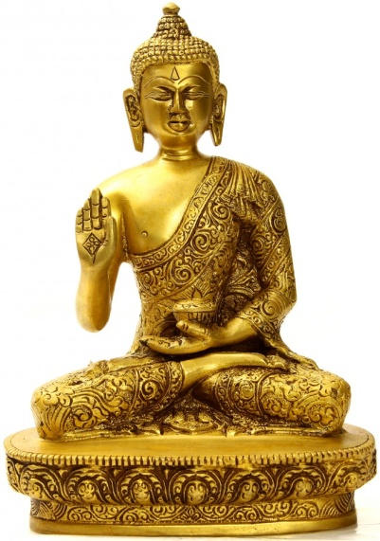

Slide 33
4. Vitarka Mudra
Teaching, Giving Instruction, Reason. The hand is held closer to the chest than in the Abhaya Mudra. The palm is facing outward. A circle is made with the index finger and the thumb. The other three fingers point upward. Initially made with the right hand, later on the gesture is often portrayed with both hands. Common gesture in Dvaravati Buddha images. Sometimes also substituted for the Dharmachakra Mudra (see below). The Vitarka Mudra can be made while in sitting or standing position.

Slide 34
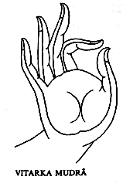
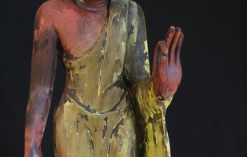
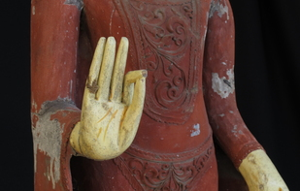
The Gesture of Debate explaining the Buddha’s teachings (Vitaka Mudra) with the hands raised and the tips of the forefingers and the thumbs touch each other.

Slide 35
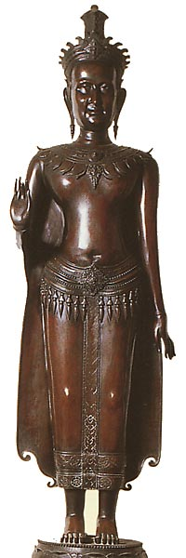
Buddha, wearing the attributes of Royalty, in the Khmer style of the Lopburi period. With the gesture (see right hand) of preaching. Cast and enlarged from an old model. Image present in the cloister of the Ubosoth at Wat Benchamabophit, Bangkok.

Slide 36
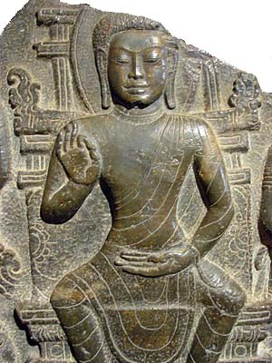
Stone carving of scene from the Buddha's life. Dvaravati art 7th-11th century A.D. The Lord Buddha is seated in so-called 'European' fashion. Phra Pathom Chedi National Museum (Nakhon Pathom) Original found at Wat Sai, Nakhon Pathom

Slide 37
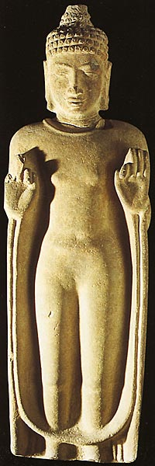
Dharavati art - Standing Buddha with two hands displaying Vitarka Mudra. 7- 9 th century A.D. Found at Si Mahosot. Now present at National Museum, Prachinburi.

Slide 38
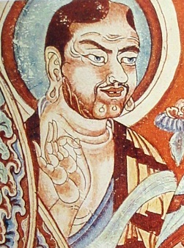
Vitarka mudrā, Tarim Basin, 9th century

Slide 39
5. Dharmachakra Mudra - Turning the Wheel of the Law in Motion.
Some gesture with both hands as in Vitarka Mudra. However the hands are generally held closer to the chest of the Buddha. However the fingers of the left hand rest against the palm of the right hand (as if turning the wheel, made by the index finger and thumb of the right hand). Rarely seen in this 'classic' representation in Thailand. The Dharmachakra Mudra signifies the teaching of the first sermon of the Buddha at the Deer Park in Sarnath.

Slide 40
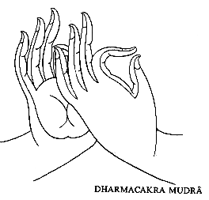
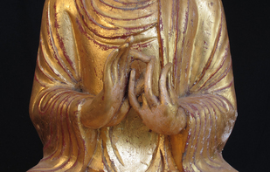
The Gesture of Teaching (Dharmacakra Mudra) with both hands in front of the breast, tips of the index finger and the thumps touching.

Slide 41
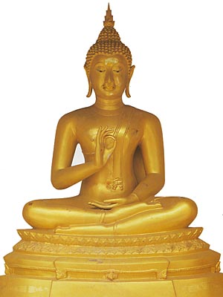
Preaching the First Sermon The Buddha went to the Deer Park at Isipatana near Benares and preached his first sermon to a group of Five Disciples. Buddha image at Phra Pathom Chedi.

Slide 44
6. Varada Mudra Symbolizing Charity.
The hand lowered with the palm facing outward is the gesture of bestowing blessings or of giving charity. The hand is extended downward, palm out. Mostly on standing Buddha images, but sometimes also represented in the sitting position.

Slide 45
The Gift bestowing Gesture of Compassion (Varada Mudra) the right hand pendant with the palm turned outwards.

Slide 46
Blessing (with sitting or standing posture) The right hand is pending in vada mudra. When standing the left hand will clasp the edge of the monastic robe. No particular story attached. It denotes the altruistic quality of the Buddha.

Slide 47
Gupta style Buddha image. Original found in Nakhon Pathom. Presently a National Museum Bangkok.

Slide 48
Standing Buddha image. Indian (Gupta) style. Found at Sarnath, Varanasi, India. Original now in the National Museum, Bangkok.

Slide 50
Inventory of Gestures in the Art of Thailand
A. Turning the wheel of the Law
1. Dvaravati (Mon): one or both hands, with the thumb and forefinger joined, raised in front of the chest. The Buddha is seated, sometimes with legs folded, but more often in the Western mode with legs in front and feet on the ground
Represents:
First sermon at Sarnath;
Preaching in the Tavatimsa heaven or
The Great Miracle at Sravasti
2. Srivijaya: Many votive tablets of clay depict the Buddha preaching the first sermon at Sarnath and demonstrating the miracle at Sravasti.

Slide 51
B. Meditation
Dvaravati (Mon): the Buddha often sits with the legs crossed at the ankles. Both hands rest in the lap.
Variants:
Single figure meditating;
Buddha in mediation sheltered by Mucalinda, the king of the nagas whose coiled serpent body forms a seat and whose hood (with five or seven heads) is spread above.
2. Srivijaya: Buddha seated on the naga
3. Lopburi: Seated with one leg resting on top of the other.
4. Sukhothai: the figure sits with one leg resting naturally on top of the other (virasana)
5. Lan Na (Northern School): Not frequently represented.

Slide 52
C. Calling the Earth to witness
1. Dvaravati (Mon) (not popular):
Variants:
a. Relief in National Museum at Nakhon Pathom depicted with folded legs crossing at the ankles; and
b. Votive tablets and a few bronzes represented with the legs tightly crossed, both footsoles visible (vajrasana)
2. Srivijaya: Most frequent attitude.
3. Lopburi: The figure sits with one leg resting on top of the other (not tightly crossed)
4. Lan Na (Northern School): the figure sits with either the legs tightly crossed so that each foot rests on the opposite leg, with the soles turned up (vajrasana) or else in a relaxed manner similar to Sukhothai figures (virasana)
5. Sukhothai: very popular,
6. Utong: Most popular representation with one leg resting on top of the other and the right hand performing the gesture.
7. Ayuthaya: Frequent examples represent the Buddha as standing.

Slide 53
D. Dispelling fear
1. Dvaravati (Mon) : the Buddha stands with one or both forearms extended forward horizontally (popular in both stone and bronze)
2. Lopburi: Standing figures
3.Lana (Northern School): Standing figures perform the gesture of ‘dispelling fear’
5. Sukhothai: Walking Buddha, with one hand performing the gesture of ‘dispelling fear’ while the other arm swings naturally at the side. A good example may be seen at Wat Phra Si Ariyabot Kamphaeng Phet.
6. Utong: Standing figures perform the gesture with one or both hands.
7. Ayuthaya: Frequent examples represent the Buddha as standing.

Slide 54
E. Bestowing favours
1. Dvaravati (Mon) : the Buddha stands with one arm pendent at his side, the hand open and the palm visible (popular in stone).
2. Lopburi: Standing figures

Slide 55
F. Instruction
1. Dvaravati (Mon) : the Buddha stands with one or both forearms extended forward horizontally (popular in both stone and bronze)
2. Lopburi: Standing figures
3.Lana (Northern School): Standing figures perform the gesture of ‘dispelling fear’
5. Sukhothai: Walking Buddha, with one hand performing the gesture of ‘instruction’ while the other arm swings naturally at the side.
6. Lan Na: Standing figures

Slide 56
G. Converting the Creatures
1. Dvaravati (Mon) : Some Dvaravati (Mon) depict the Buddha performing the gestures of ‘dispelling fear’ or ‘instrcution’ with one hand and ‘bestowing favours’ with the other. This combination has continued until the Rattanakosin (Bangkok) period.

Slide 57
H. The Buddha in royal attire
1. Lopburi: The Buddha is clad as a king with decorated crown, earrings, necklace, arm bands, bracelets, angkles and waistband, the monastic attire and royal waistband may be combined.
2.Lana (Northern School): A few standing Buddhas are depicted in this manner.
3. Ayuthaya: Many examples exist.
4. Rattanakosin (Bangkok) Period: common examples.

Slide 58
I. Resting or Reclining
1. Sukhothai: Not frequently represented.
2. Lanna (Northern School): A few examples exist.
3. Utong: Some depictions only.

Slide 59
J. Walking
1. Sukhothai: (in the round), supposedly originated by artists here.
2.Lana (Northern School): A few examples are known; some of them depict the Buddha ‘making a footprint’.
3. Utong: Some representations exist.
4. Rattanakosin (Bangkok) Period: Revived an interest in this posture. The most impressive example is found at the Phutthamonthon Park, Nakhon Pathom province.

Slide 60
K. Carrying the alms bowl
1. Lana (Northern School): The Buddha stands holding the bowl.
2. Rattanakosin (Bangkok) period: Revived, especially during the third reign (1824-51).

Slide 61
Thank you

