Slide 1
Assignments
Buddhism & Social Works
Phramaha Somphong Santacitto, Ph.D.

Slide 2
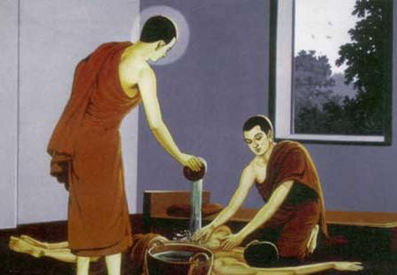

Slide 3
Buddhism & Social Works
Somphong S. Dr.

Slide 4


Slide 5
List of Buddhism and Social Works
1. Education of the adult public;
2. Education of children;
3. Working with the sick in hospitals and hospices;
4. Working with the sick and dying in the community and in palliative care;
5. Visiting prisons;
6. Working with drug addicts;
7. Fundraising for the poor and needy (both in Asean and overseas);
8. Speaking up for human rights and against oppression;
9. Compassionate activities on behalf of non-human sentient beings.

Slide 6
How to do
Theory and Principle of Social Works
Types of social works
Buddhist Social works
A Case Study: Your own case
Step or process for doing social works
Person who is in charge or committee
Projects (activities) and works

Slide 7
Five Scopes
Content Area or field placement: What kind of fields can we do social work?
Place Area: Where can we do social work?
Population Target: Who do we can do social work with?
Timing Conditions: When do we can do social work?
Procedures/Method: Which way (How) do we can do social work?

Slide 8
Instructions:
Take the assigned topic one by one,
Write the 8 page assignment as well as 10 slide powerpoint.
Do class presentation each.
Submit full paper and powerpoint.
Deadline is 30 October, 2015

