Slide 1
Gautama Buddha in Myanmar Style
Subject: Buddhist Arts
Lecturer By: Dr.Somphomg Santacitto
Presented By: Ven,Htera vamsa
ID. 5701201105

Slide 2
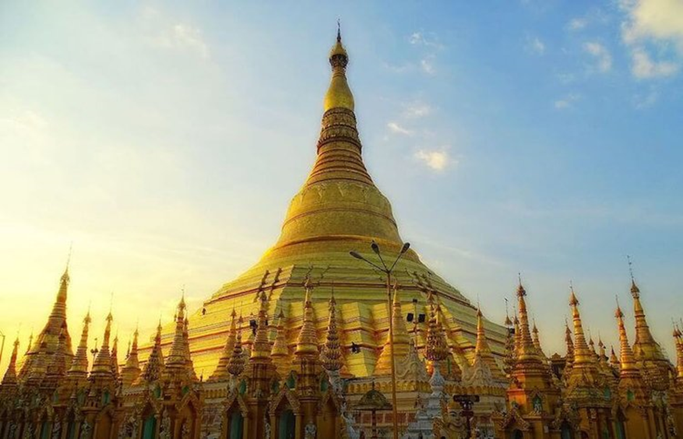
Shwedagon Pagoda in Yangon
Historians and archaeologists maintain that the pagoda was built by the Mon people between the 6th and 10th centuries AD.[2] However, according to legend, the Shwedagon Pagoda was constructed more than 2,600 years ago, which would make it the oldest Buddhist stupa in the world. Height (max) 105 m (344 ft) Spire height 112.17 m (368 ft)

Slide 3
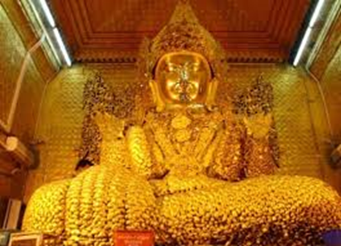
Mahamuni Pagoda in Madalay
The temple, arguably the most important to the residents of Mandalay, was built to house a 12-foot (3.8-meter) tall statue of the Buddha that was already ancient when King Bodawpaya conquered Arakan and claimed it in 1784. According to local legend, the statue was cast while the Buddha was still alive, but it was more likely cast some six centuries after his death, somewhere around 150 AD. No matter its origins, the statue is highly venerated by devotees — evidenced by the inches thick layer of pure gold leaf that has been added to the metal statue over the centuries.

Slide 4
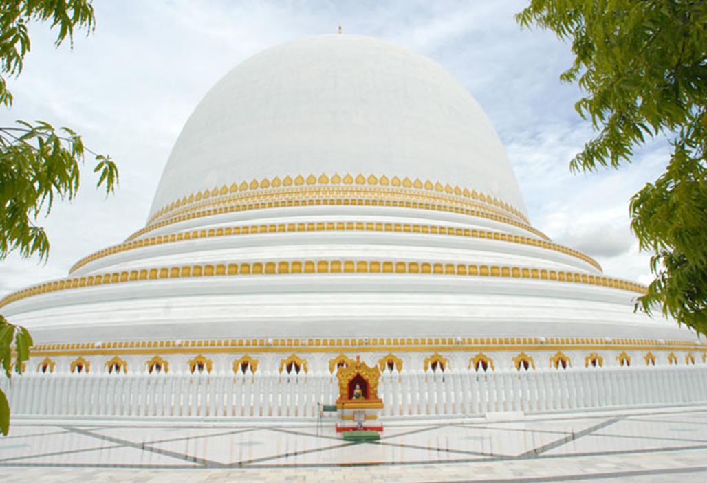
Kaungmudaw Pagoda – Sagaing
Kaungmudaw Pagoda, also called Yaza Mani Sula, is a huge pagoda 10km beyond the town of Sagaing in central Myanmar. It was built by King Thalun and his son in A.D 1636. The dome shaped pagoda rises up to 46 meters. At the base of the pagoda, there are 812 stone pillars, each one with a hollow and an image of a Nat in it. It was modeled after the Mahaceti Pagoda in Sri Lank.

Slide 5
The stupa enshrined the Buddhist relics inside its relic chamber. The pagoda dome had been continuously painted white to signify purity but now gilded with gold. It is one of the famous pilgrimage and tourist,destinations in the Sagaing area.

Slide 6
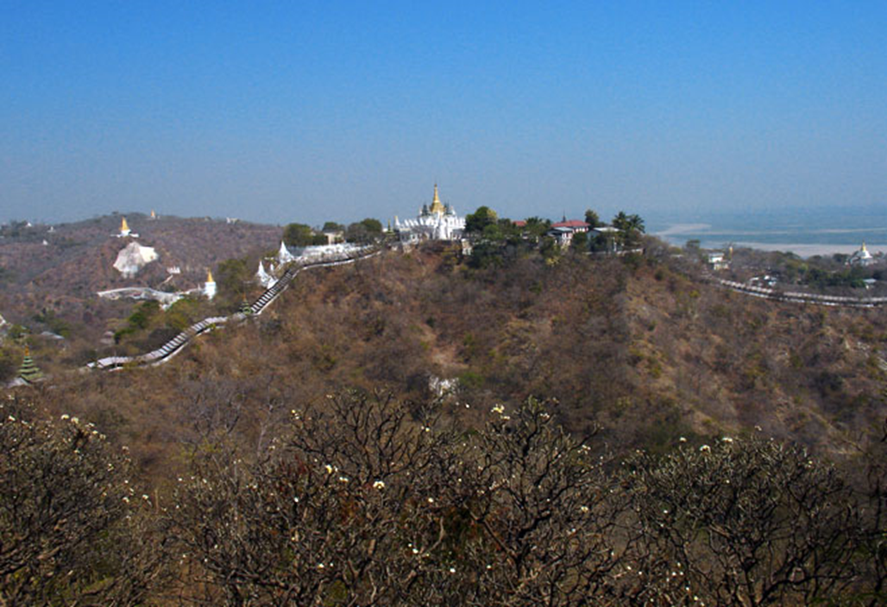
Sagaing Hill & Soon Oo Ponya Shin Pagoda
The Soon Oo Ponya Shin Pagoda is located on the top of the Sagaing Hill. It is one of the oldest temples on Sagaing Hill. All the pagodas in area, it receives the first of alms offering made. It was built in 1312 by Minister Pon Nya. Pagoda Festival is held on the fullmoon day of Waso (July).

Slide 7
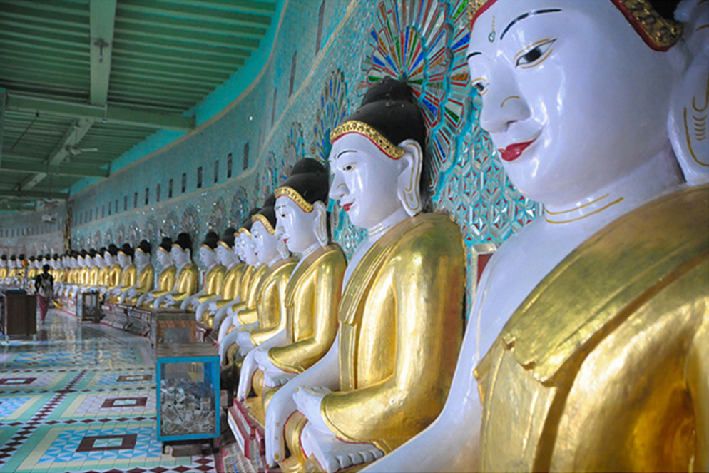
Umin Thonse Pagoda or 30 Caves Pagoda – Sagaing
Umin Thonse` Pagoda is situated on Sagaing Hills. Umin Thonse’ means 30 Caves Pagoda. It was built by venerable monk named Padugyi Thangayaza (though the date was variously given as A.D. 687, 1005,1050,1085. 45 Buddha images sit in a crescent-shaped colonnade within the pagoda.

Slide 8
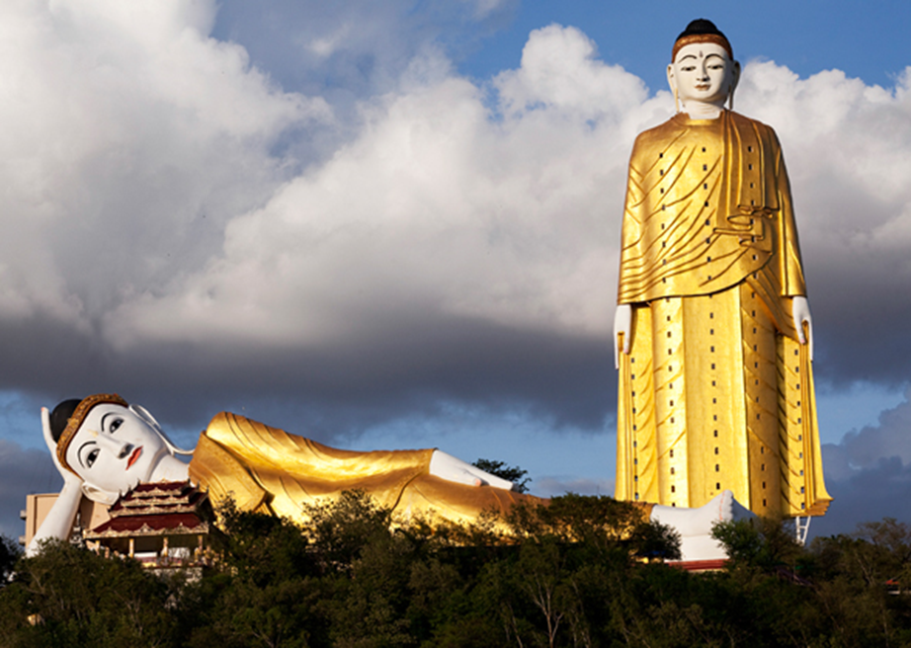
Bodhi Tahtaung Pagoda
. The pagoda was started on 20th June 1939 and completed on 2nd March 1952.It was the brain-child of the famous Mohnyin Sayadaw whose life-like effigy can be seen nearby. Bodhi Tahtaung Pagoda in Monywa has one thousand Bodhi Trees and each tree has a large Buddha Image underneath. It was established by Bodhi Tahtaung Sayadaw in 1960s. Po Khaung Taung, a range of hills, lies east of Bodhi Tahtaung Pagoda. The largest reclining Buddha image in the world which is 91 meters long is lying on that hill.

Slide 9
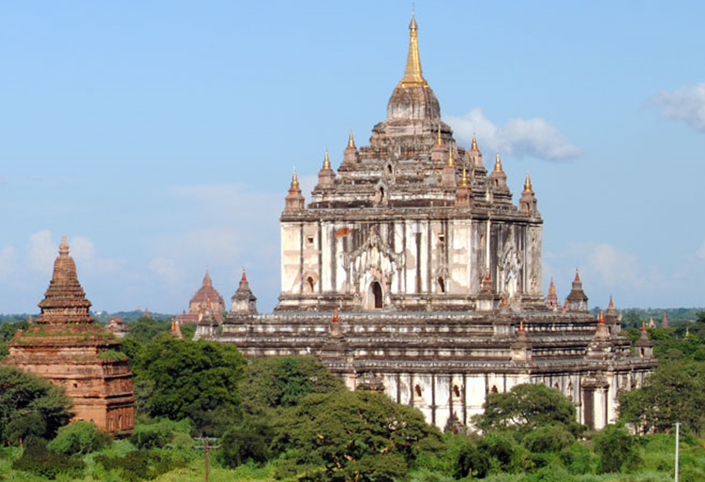
Thatbyinnyu Pagoda in Bagan
The temple was built about the middle of the 12th century A.D. by King Alaungsithu, grandson and successor of the King who erected the Ananda. Standing within the city walls, some 500 yards to the south-west of the Ananda, the Thatbyinnyu rises to a height of 201 feet above the ground and overtops all the other monuments.

Slide 10
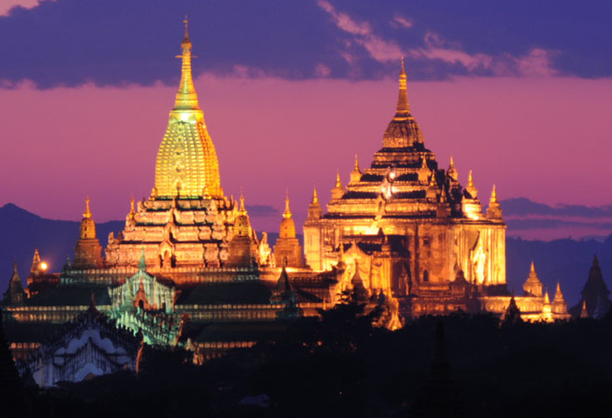
Ananda Pagoda in Bagan
. Built by Kyanzittha in 1091 A.D., it is one of the finest and most venerated temples at Bagan. The images are represented in the following order: north-Kakusanda; east-Konagamana; south-Kassapa; and west- Gautama. Each of them is 31 ‘feet high above the throne, which itself is nearly 8 feet in height.

Slide 11
Thanks your for listening

