Slide 1
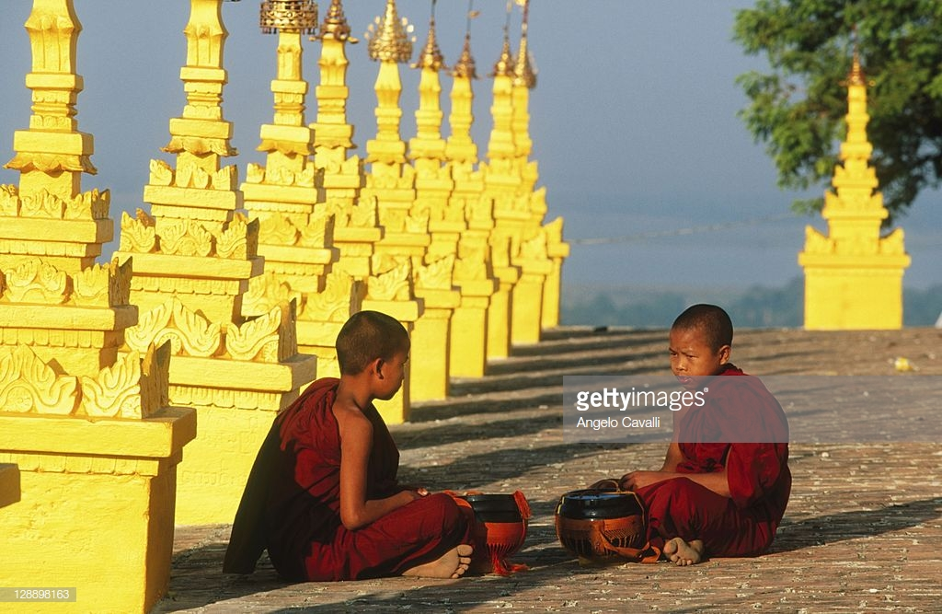
Sagaing{Burmes} Ven.Shbhogha ID.5801201134

Slide 2
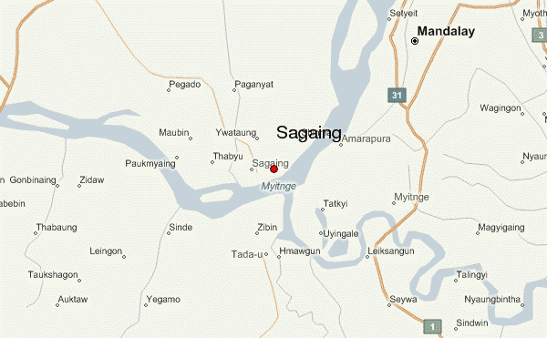
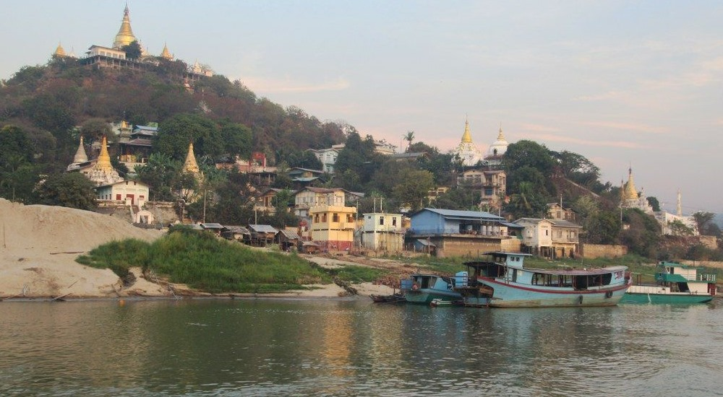
The city has population around 70,000 (Sagaing-Mandalay metro area over 1,8 million) and is popular for its pagodas and Buddhist monasteries, making it an important religious centre.

Slide 3
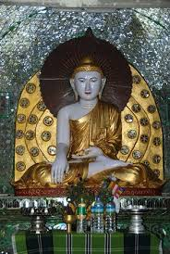
Kaunghmudaw Pagoda The Kaunghmudaw Pagoda Yaza Mani Sula Kaunghmudaw is a large pagoda on the northwestern outskirts of Sagaing in central Myanmar Burma

Slide 4
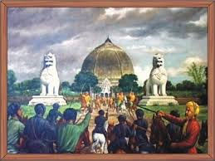
Modeled after the Ruwanwelisaya pagoda of Sri Lanka, the Kaunghmudaw is known for its egg-shaped design, which stands out among more traditional-style, pyramid-shaped Burmese pagodas.

Slide 5
Construction Construction began during the reign of King Thalun on 25 April 1636 (Friday, 8th waning of Kason 998 ME). The pagoda's relic chamber was dedicated on 23 July 1636 (Wednesday, 7th waning of 2nd Waso 998). The pagoda was completed 12 years later on 12 May 1648 (Tuesday, 6th waning of Kason 1010) towards the end of Thalun's reign

Slide 6
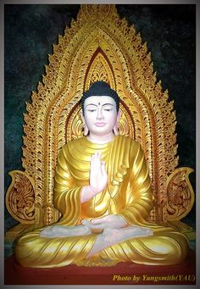
Architecture The pagoda is 46 metres (151 ft) high and has a circumference of 274 meters. The hti (umbrella or crowning) of the pagoda is 7.92 metres (26.0 ft) high and weighs 3.5 kilograms (7.7 lb) (3440 viss). The pagoda differs from the traditional Burmese-style pyramidal structures by having an arched image chamber in the center of its base. The chamber houses a massive seated 7.3 metres (24 ft)-high Buddha statue, carved out of solid white marble.

Slide 7
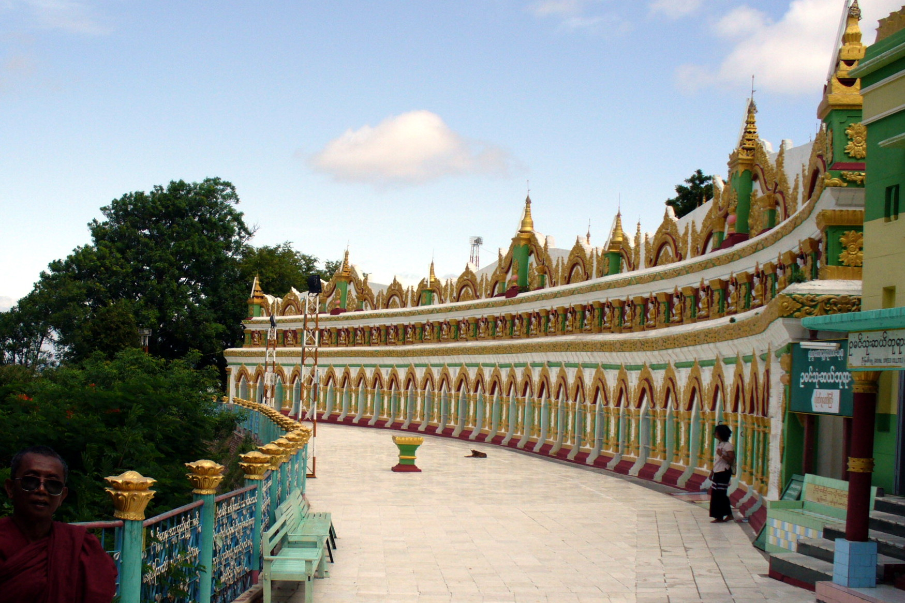
The head of the Buddha statue alone is about 2.4 meters in diameter. It is believed that the dome was built later around the massive statue.The lowest terrace of the pagoda is decorated with 120 nats and devas. It is ringed by 802 stone lanterns, carved with inscriptions of Buddha's life in three languages: Burmese, Mon and Shan Yuan, representing the three main regions of Restored Toungoo Kingdom.

Slide 8
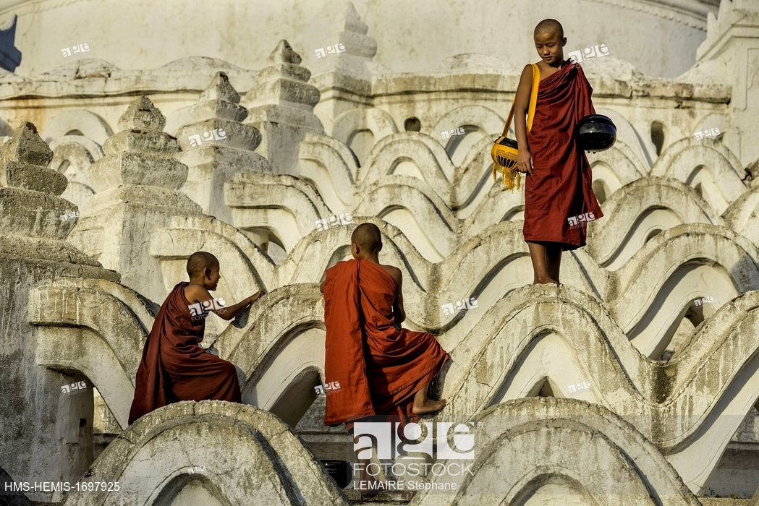
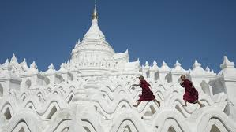
The pagoda dome has been continuously painted white to signify purity, in Ceylonese tradition. According to local lore, the relic chamber of the pagoda contains the lower left tooth relic of the Buddha, hair relics, an alms bowl, statues, pagodas and other relics

Slide 9
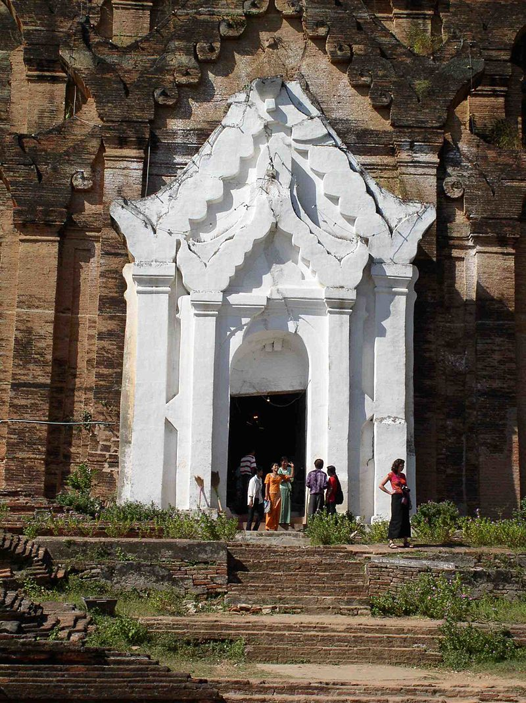
Mingun Pahtodawgyi The Mingun Pahtodawgyi is an incomplete monument stupa in Mingun, approximately 10 kilometres (6.2 mi) northwest of Mandalay in Sagaing Region in central Myanmar (formerly Burma).

Slide 10
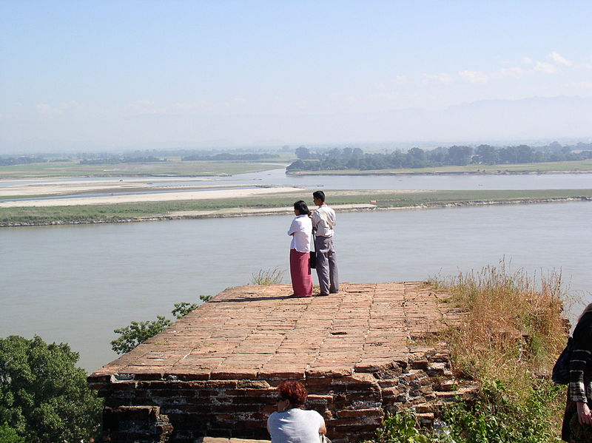
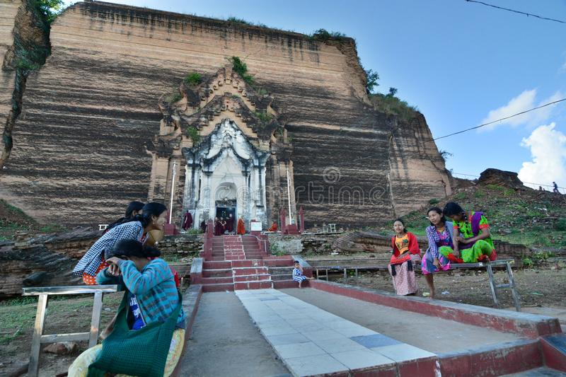
The ruins are the remains of a massive construction project begun by King Bodawpaya in 1790 which was intentionally left unfinished. The pahtodawgyi is seen as the physical manifestations of the well-known eccentricities of Bodawpaya. He set up an observation post on an island off Mingun to personally supervise the construction of the temple.

Slide 11
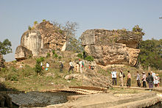
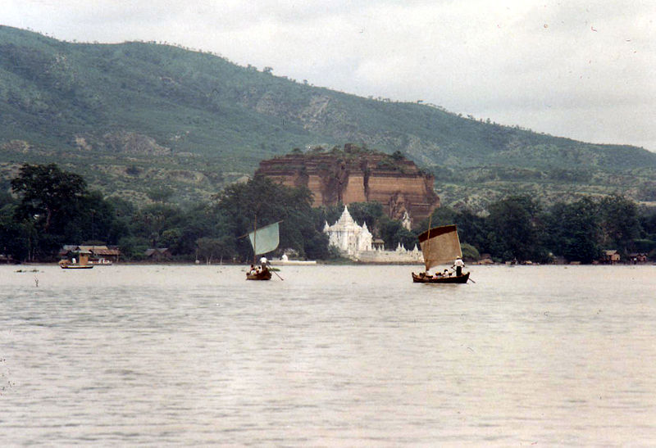
Incompletion Pon Daw Pagoda situated near Mingun Pagoda is the 15 feet completed model of Mingun Pagoda. Bodawpaya used thousands of prisoners of war from his expansionist campaigns and slaves working on the construction of the stupa. The construction was also seen as having a heavy toll over the people and the state, thus a prophecy was allegedly created, to stop the project

Slide 12
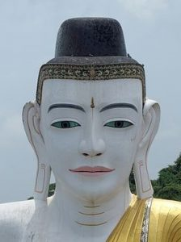
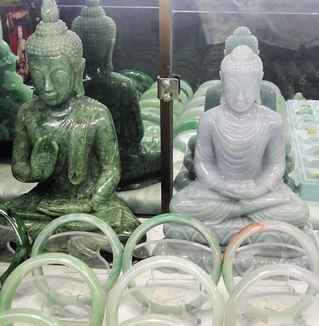
The approach in conveying the dissatisfaction was allegedly to utilize the King's deep superstition. The prophecy went "as soon as the building of the pagoda was over, the country would also be gone".

Slide 13
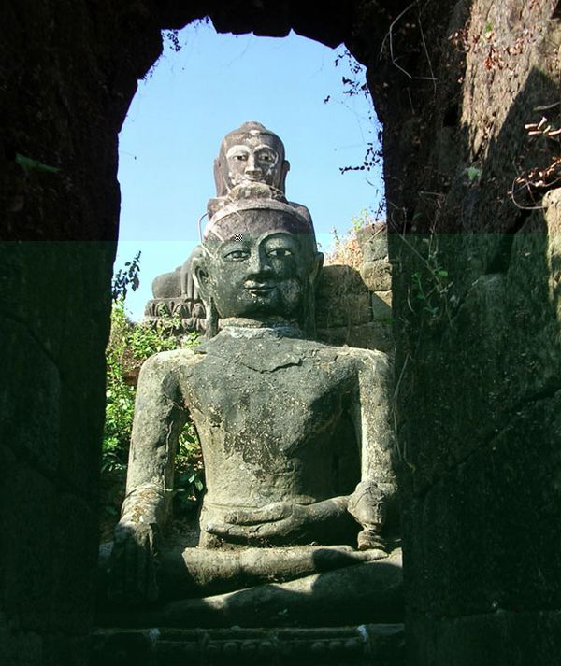
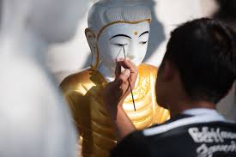
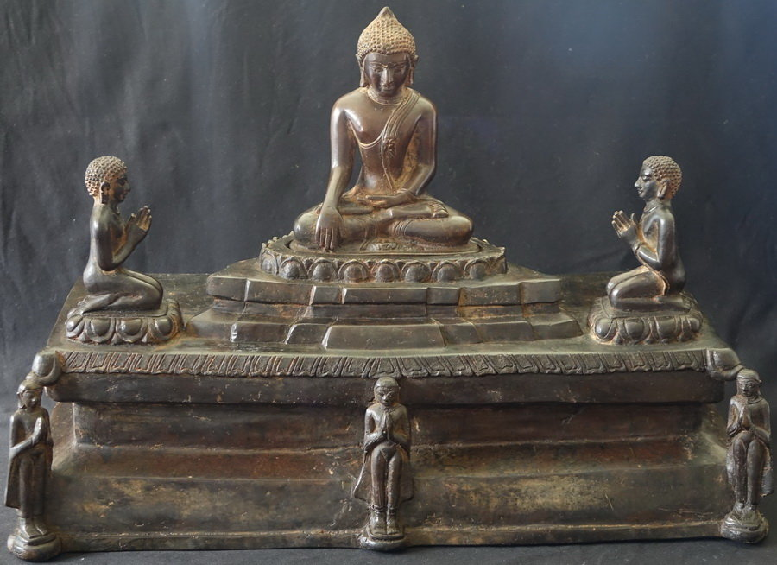
A variation states that king would die once the project was completed. Thus, construction was slowed down to prevent the prophecy's realization and when the king died, the project was completely halted. A model pagoda nearby, typical of many large pagoda projects like the Shwedagon Pagoda and Thatbyinnyu Temple, offers a small scale of what would have been a 150 metres tall temple. However, it holds the record of being the largest pile of bricks in the world

Slide 14
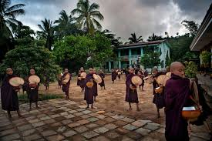
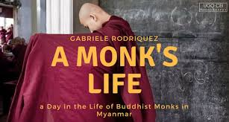
Thank you

